Slide 1
Road Maintenance
Notes:
Rev. April 2021

Slide 2
Identified Roads
Roads are identified for each Fiscal Year (FY) by incorporating input from:
Engineer condition coded maps
Road and Bridge Department personnel
Residential input
Roads are coded into four categories:
Good
Fair
Poor
Unimproved (gravel)

Slide 3
Maintenance Techniques
Full Depth Reclamation (FDR) on poor roads
Base and Asphalt are pulverized, then roadway is re-stabilized with cement slurry.
Asphalt milling and overlay on fair roads
Only Asphalt surface is removed, and new asphalt surface is laid.
Rejuvenation on fair roads with known stable subbase
Specialized Asphalt emulsion oils are sprayed on asphalt to restore original strength and flex properties.

Slide 4
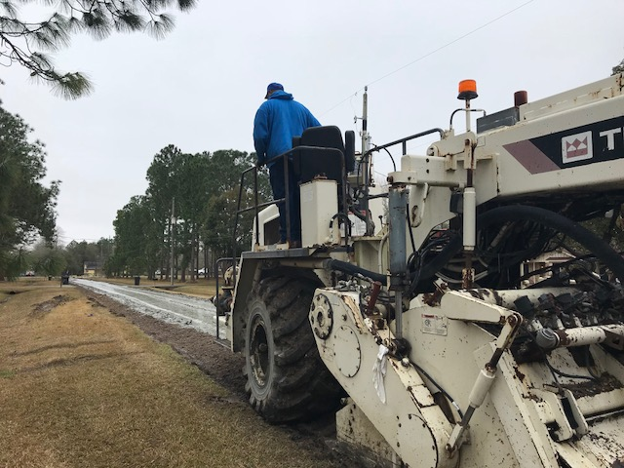
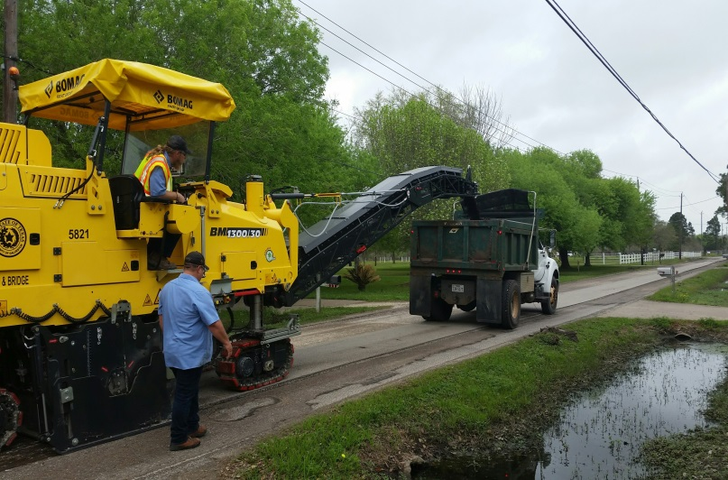
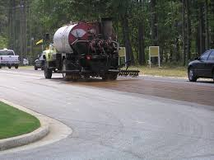
FDR/Milling/Rejuvenation
FDR
Milling
Rejuvenation

Slide 5
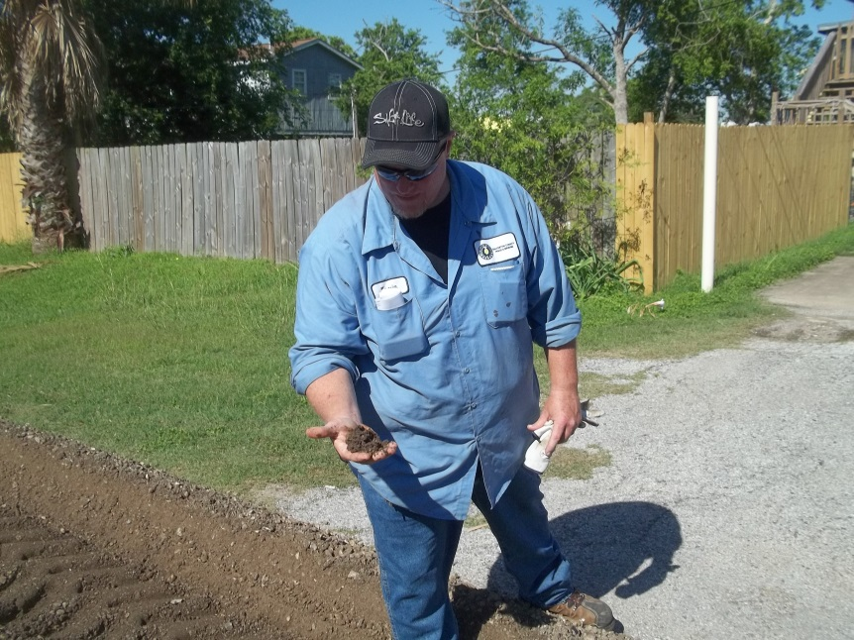
Quality Control / Quality Assurance (QC/QA)
QC/QA controls are in place in accordance with Galveston County Road and Bridge Department’s Best Practices.

Slide 6
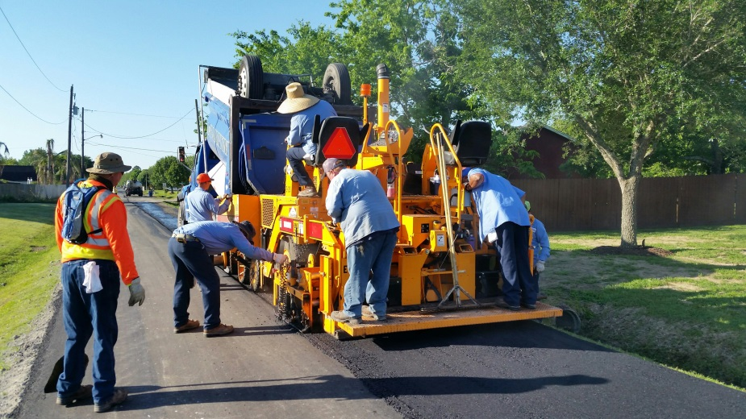
Phases of Construction
Road is pulverized and cement slurry is added to restabilize, or road surface only is removed.
Typically done in Fall/Winter/early Spring.
A temporary surface is emplaced, known as chip seal.
Done upon completion of stabilizing road base or completion of milling.
Road is paved with asphalt.
Typically done in late Spring/Summer/early Fall due to warmer dry weather necessary for laying Hot Mix Asphalt Cement.

