Slide 1
Protest Your Property Value (and immediately lower the tax burden)
Prepared and Presented by
Cheryl E. Johnson, PCC, CTOP
Galveston County Tax Assessor/Collector

Slide 2




Taxes Five Step (The Cliff Notes Version of Protesting Your Value)
Step 1. Mail, email or fax the protest form or file an online protest by May 15th (this entitles you to evidence)
Two reasons to protest – incorrect market value (likely condition concerns) or unequal compared with other properties (same house in the neighborhood valued for less) . Request the evidence packet. The amount of
your property taxes begins with the CADs valuing property (as of January 1).
Step 2. Research CAD records Request the “appraisal card” via email (gcad@galvestoncad.org) and validate information. If you recently purchased the property for less or have a recent appraisal with a lower
value, you are ready to go. If you paid more and discovered problems later or if repairs are needed,
take photos and obtain estimates. Provide this information at the informal meeting with the appraiser,
at the formal ARB hearing or submit with the online protest.
Step 3. Attend the informal conference scheduled before the ARB Hearing Review the evidence documents.
If you attend the informal and are not prepared to go to the ARB hearing, ask to be scheduled for a later date! YOU ARE LEGALLY ENTITLED TO ONE RESCHEDULE!
Step 4. Appraisal Review Board (ARB) Hearing The ARB is a three-member citizen panel appointed to hear protests. A CAD appraiser and a hearing clerk will also be in attendance. Bring 4 copies of your
evidence. After being sworn in, the CAD will present its case, you will present yours and the ARB will announce a decision. THE BURDEN OF PROOF IS ON THE APPRAISAL DISTRICT!
Step 5. Arbitration or File Lawsuit in State District Court ARB decisions can be overturned in binding arbitration or in court. Arbitration requires payment of a $450 fee (amount varies). If you are successful (meaning the arbitrator determines the value nearer to your estimate than the CAD’s), all but $50 will be
refunded. The majority of lawsuits are settled but before taking this step, consider the cost!

Slide 3
Ready?
Watch/read this presentation, download the spreadsheet and booklet (read the first five pages).
Request your appraisal card (with the sketch) from the CAD via email (see example on next slide) at gcad@galvestoncad.org. Remember to provide your property ID or account number.
Validate the information about your property on the CAD record is accurate.

Slide 4
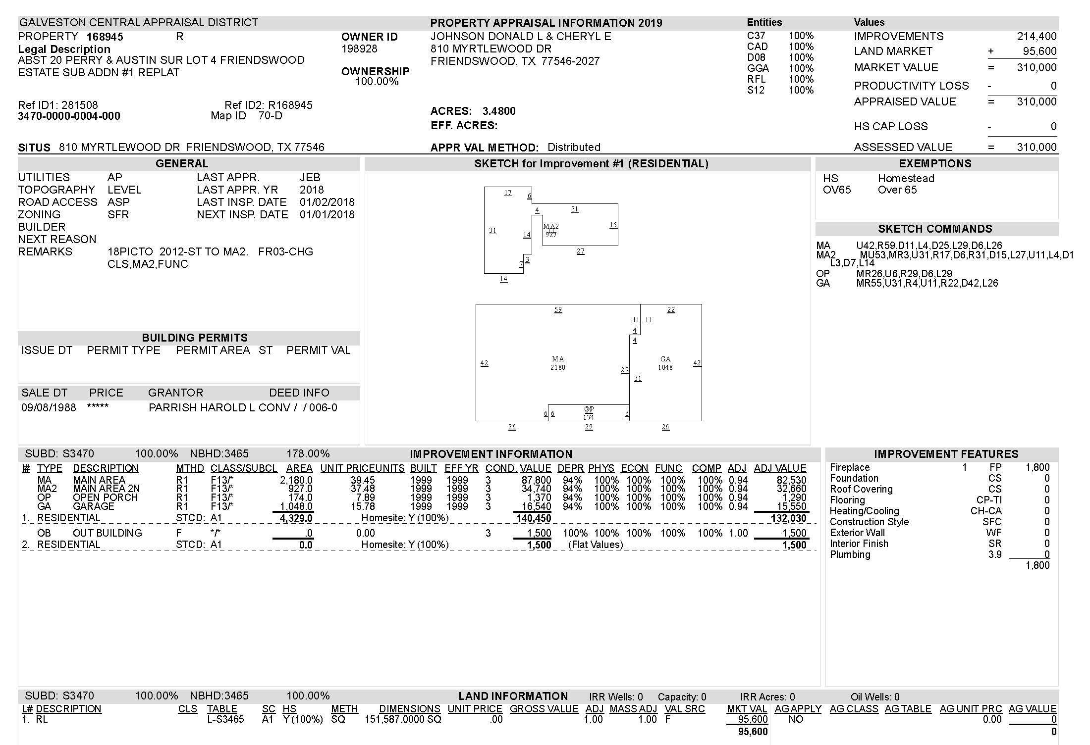
Short Acct #
Owner & address info
Your neighborhood
Long Acct #
Actual address
EXAMPLE
OF AN
APPRAISAL CARD

Slide 5
Simple Facts
Protesting is not a guarantee to lower your taxes. It is
a start and pays off over time. It is important that you understand the process and ensure the information the
CAD has is accurate for your property!
If your homestead value increased more than 10% (20% for all other real property) and you do not secure a lower increase, the taxes will STILL increase and eventually you will be taxed at the full market value. “Caps” are “tax limits” not value limits.

Slide 6
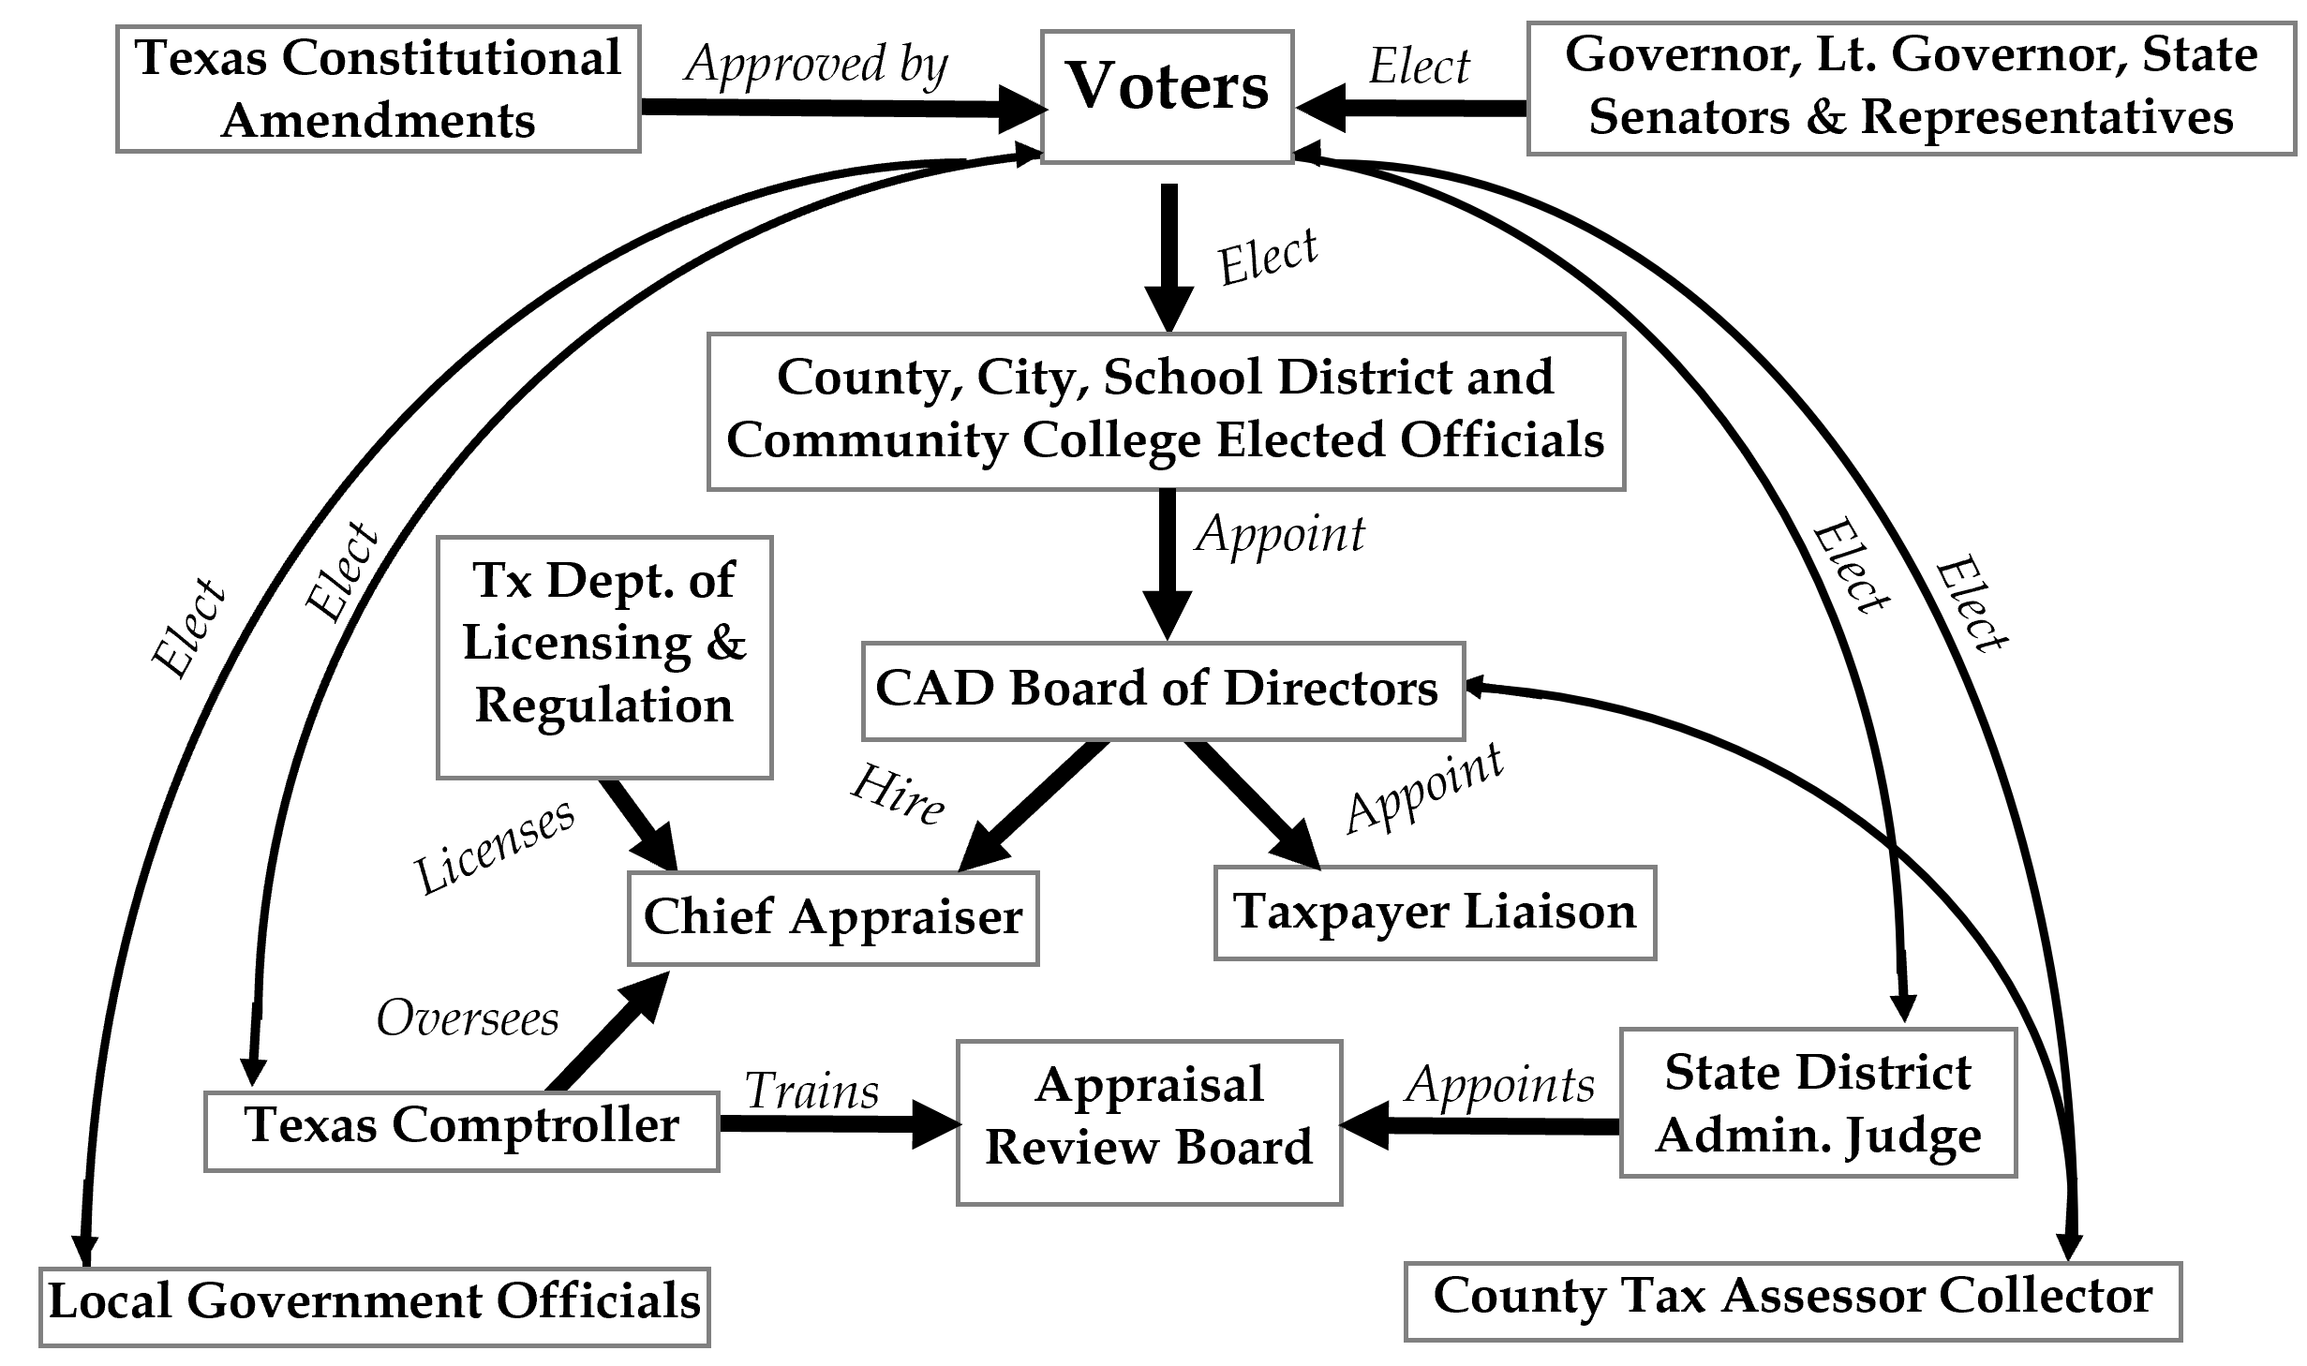
Who’s Who in the Tax Process?
Many
players but
it starts with the voters
who elect them!
Stars represent those YOU ELECT!!!

Slide 7
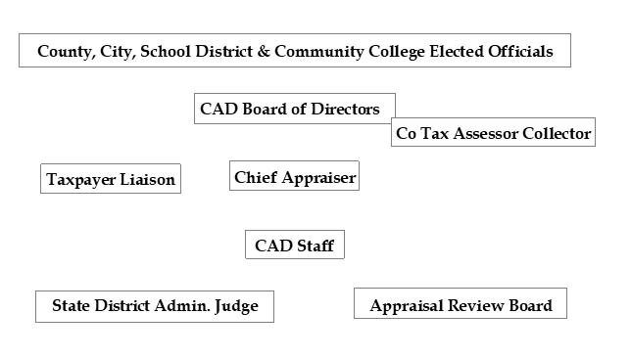
Who’s Who at the CAD?
Appoint 5 + beginning this year, 3 elected +
elected county tax assessor collector!
Hires
Hires
Hires
Appoints
Beginning in July this year, the CAD Board of Directors will appoint the Appraisal Review Board members!

Slide 8

The Process in a Snapshot
Pay if successful
Hire consultant
by 5/15!
Receive Notice
Ask 4 appraisal card
Protest MV or Unequal
HS may file
online or
Receive offer
Reduce? Sign waiver go home!
Meet with appraiser
Send in form
No reduction – go to ARB
Reduce
No reduction –Arbitration
Reduce or not
Value determined or settled
No reduction – file lawsuit
Likely AFJ with reduction

Slide 9

Big picture
CADs use “mass appraisal” to generate values. This is an imperfect but efficient way to value large numbers of individual properties.
The CAD has defined neighborhoods and when a sufficient number of sales occur in a neighborhood, values increase.
CAD assumes properties are in good condition and ready
to sell.
It is YOUR job to tell them why your property is
different from those it is comparing you to.

Slide 10
Do not be overly concerned if your land value increased.
CADs are required to “allocate” (assign) value between the improvements (anything on the land) and the land.
When the improvement value is as high as it can be (due perhaps to its condition), increases resulting from market activity are assigned to the land.
FOCUS ON THE TOTAL MARKET VALUE!

Slide 11
Market value is determined as of January 1*
Market value is the price at which a property would sell if:
  exposed for sale a reasonable amount of time
  all parties are aware of the uses and restrictions, and
  neither is taking advantage of the other nor is either
  party highly motivated to buy or sell
  Section 1.04(7) TX Property Tax Code (page 5 of booklet)
a reasonable amount of time
aware of the uses and restrictions
highly motivated to buy or sell
  2024 sales can be used if truly comparable/in the neighborhood

Slide 12
Online Protest
Only homesteaded property owners may file for an online protest this year (considered the informal conference). ONLY DO THIS if you have supporting documents (eg recent contract or appraisal or actual bids for repairs, photos of damage or insurance claims)
www.galvestoncad.org
Email response sent from no-reply@trueautomation.com
(save in your contacts). Do not lose this option because it went to Junk Mail!!!

Slide 13
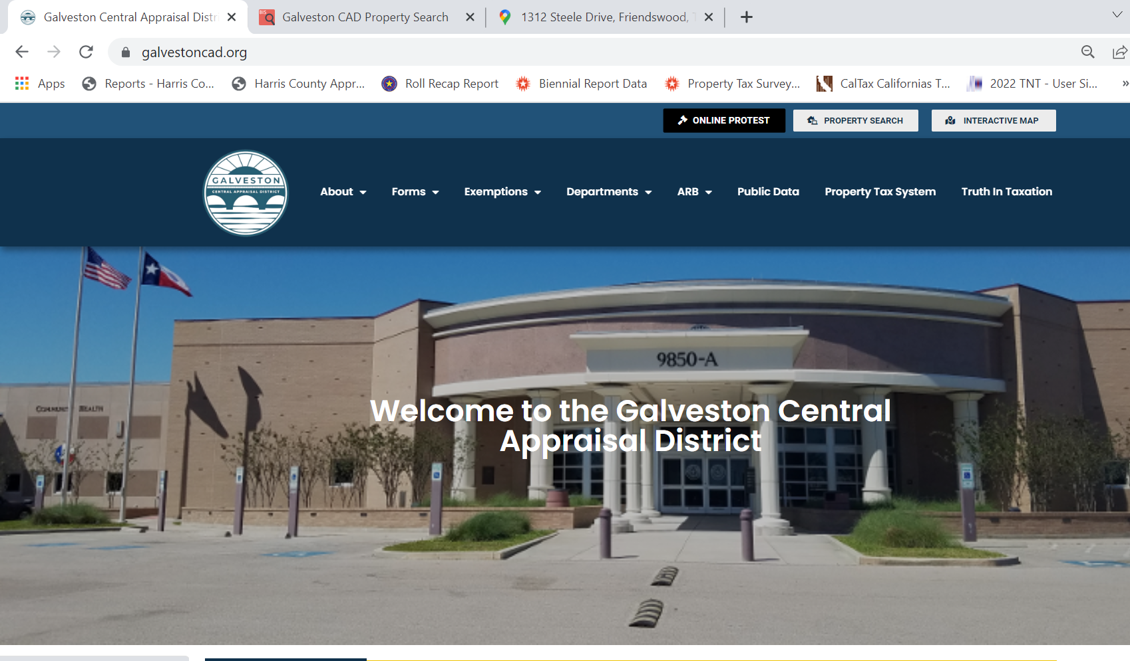
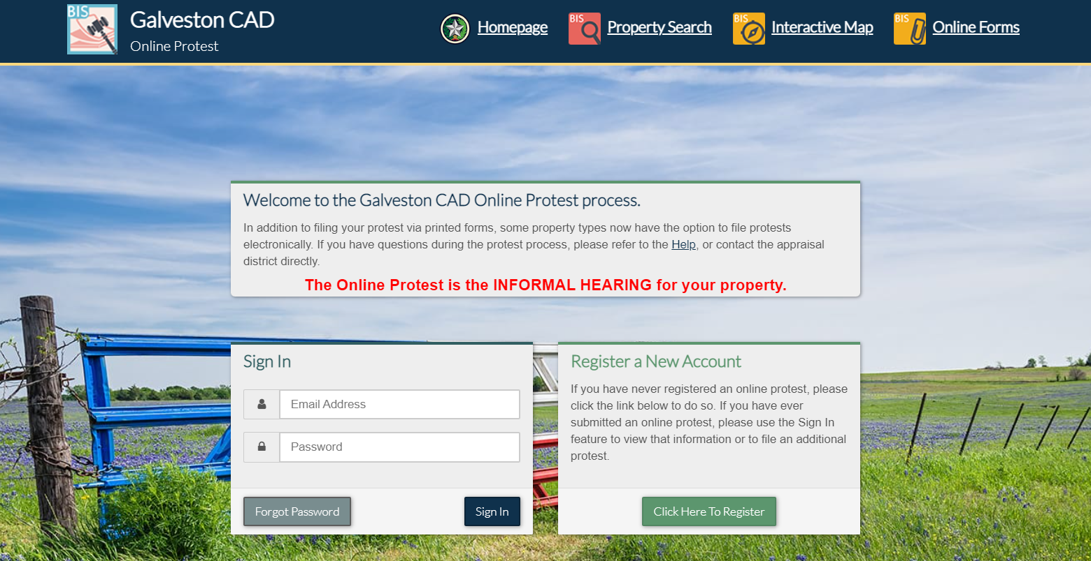
(www.galvestoncad.org)

Slide 14
In the Meantime
Locate your neighborhood from the GCAD website so that you have an understanding of what properties you are being compared to and begin doing some research

Slide 15
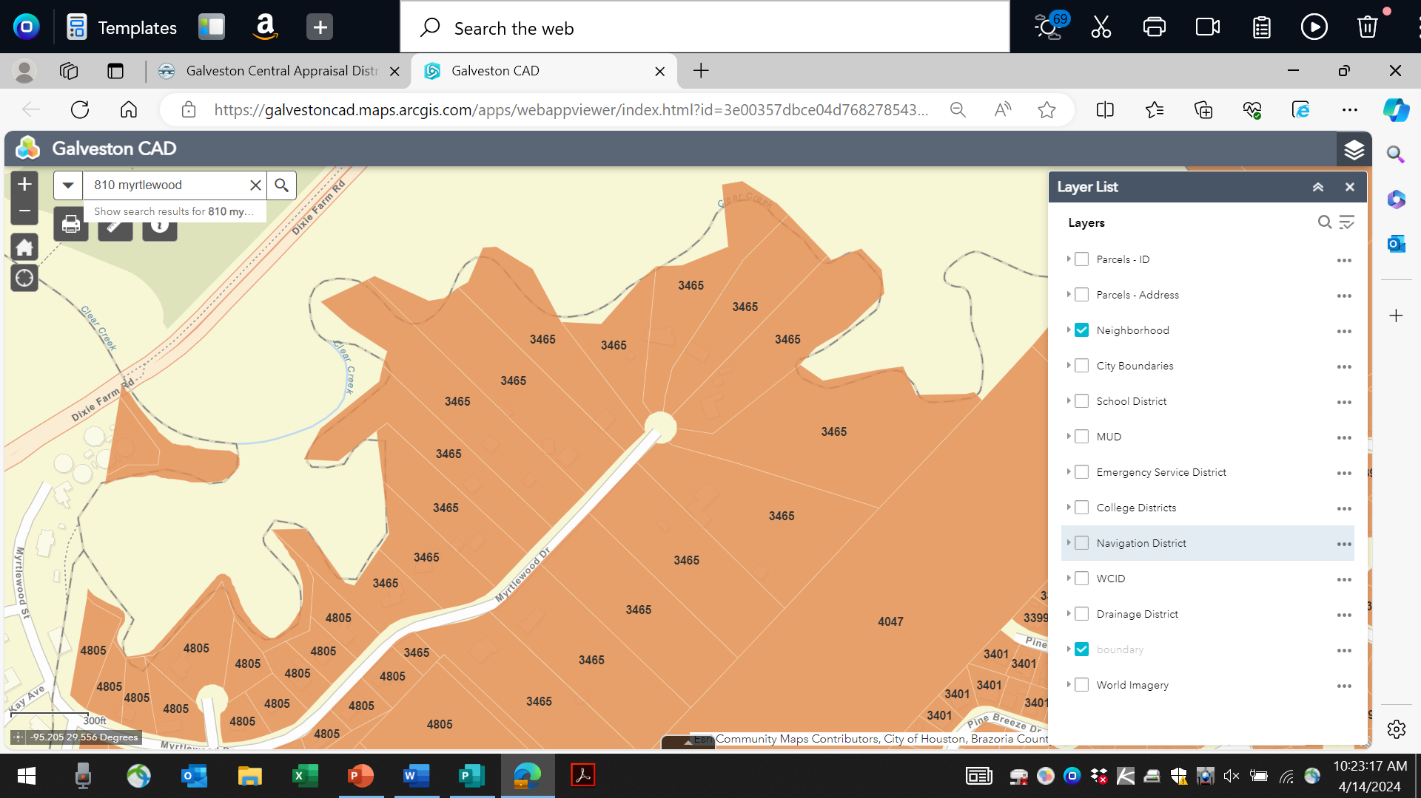
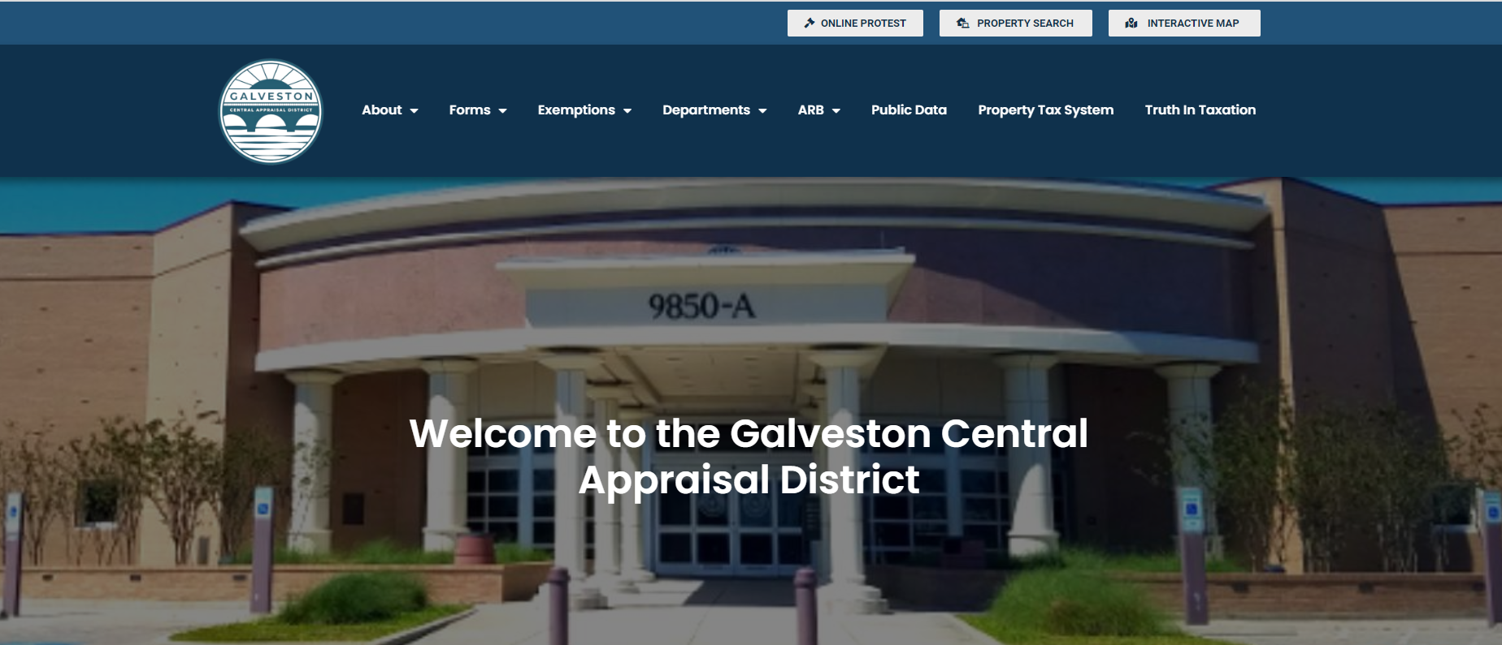
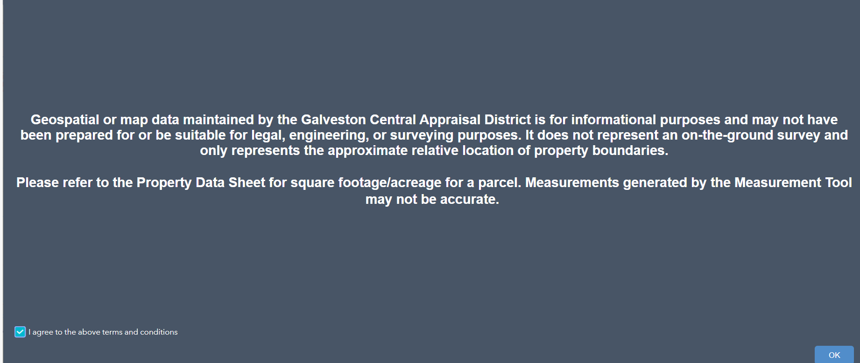
Locating Neighborhood Online
www.galvestoncad.org
Same number (3465) are properties in your neighborhood

Slide 16
While Waiting for Notice of ARB Hearing & Evidence Packet
You have reviewed the appraisal card for accuracy
Prepared a list of needed repairs/upgrades that would be needed in order to sell your home in the current market
Obtained bids if you can – take photos at a minimum

Slide 17
The Process
You will receive a notice to attend the ARB hearing which will inform you to attend informal first (it states to arrive 15 minutes ahead of ARB – I suggest 30). By law, the notice must be delivered via certified mail, email or through regular mail 15 days before the hearing.
You must also receive requested documents (Evidence Packet) 14 days before the hearing

Slide 18
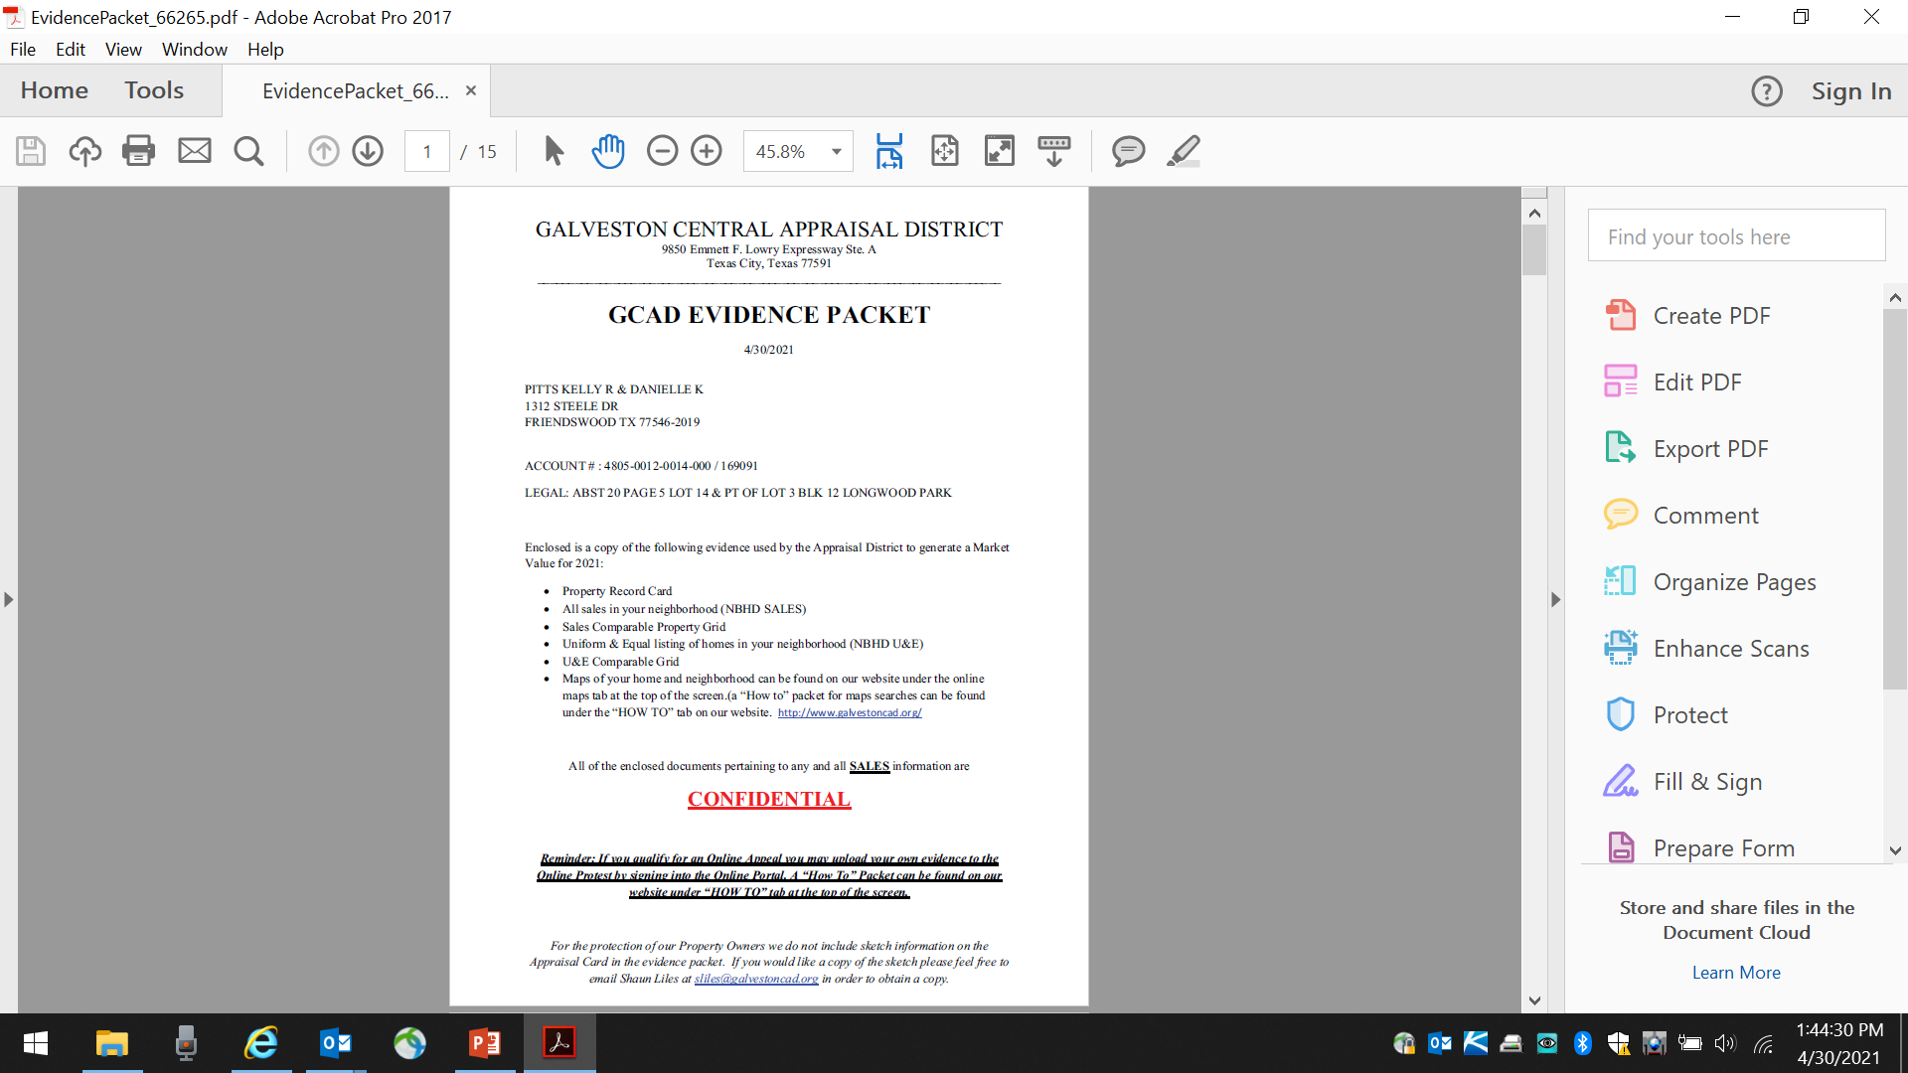
Evidence Packet
YOUR NAME, ADDRESS ACCOUNT NUMBER & LEGAL DESCRIPTION

Slide 19
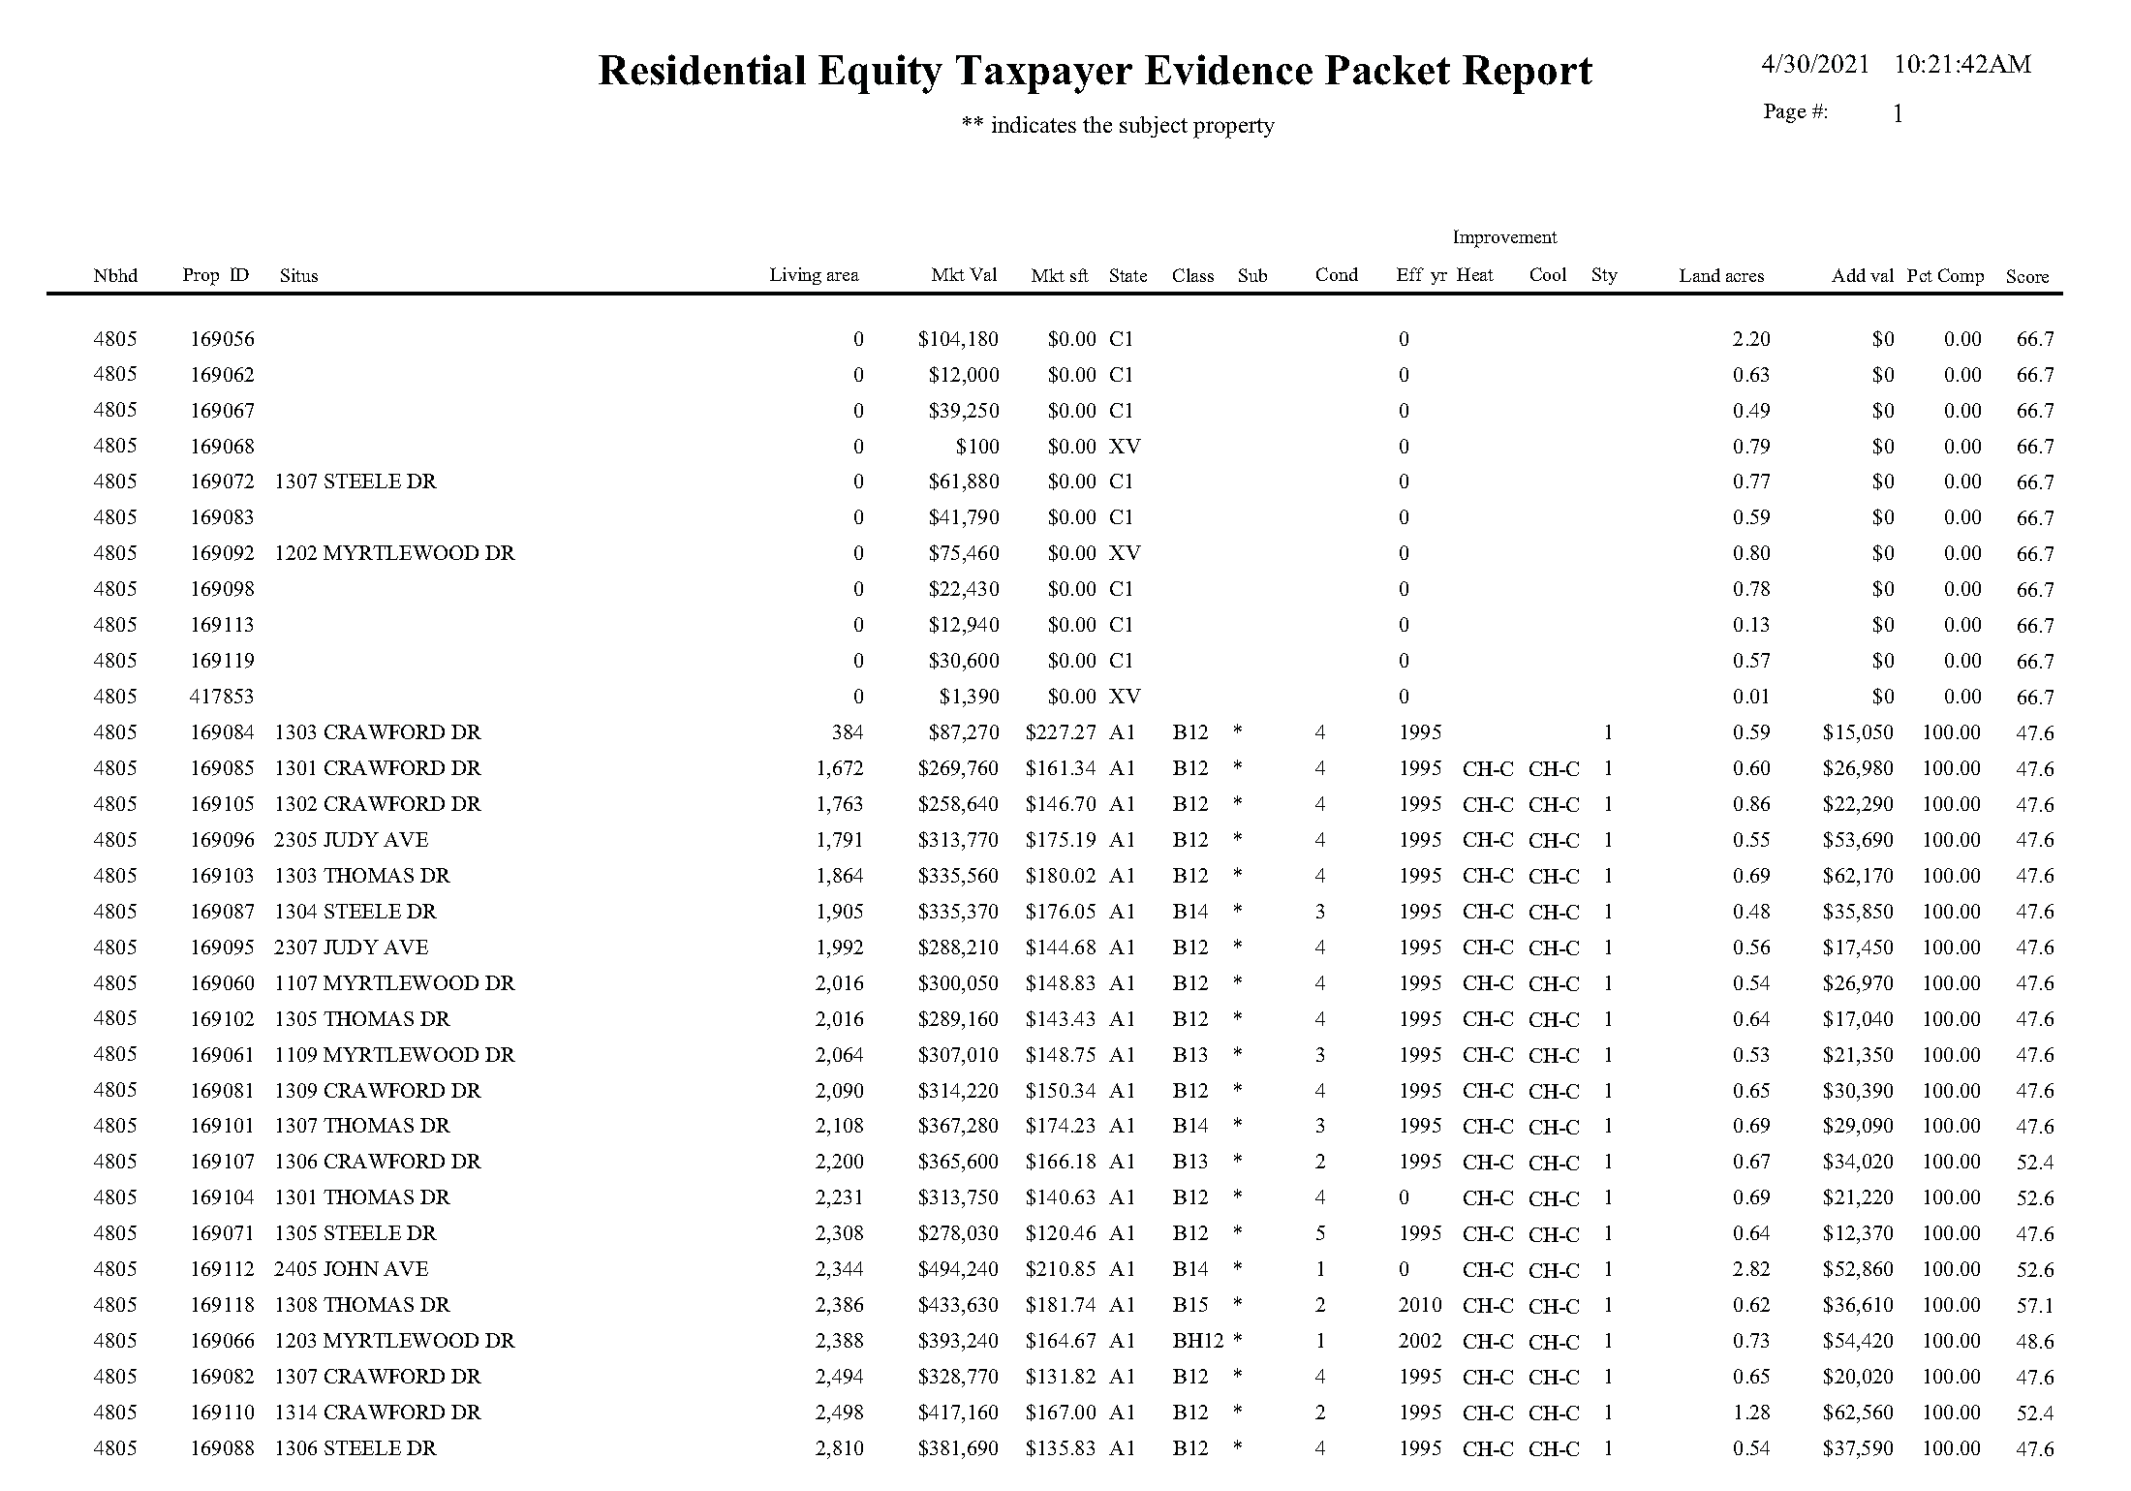
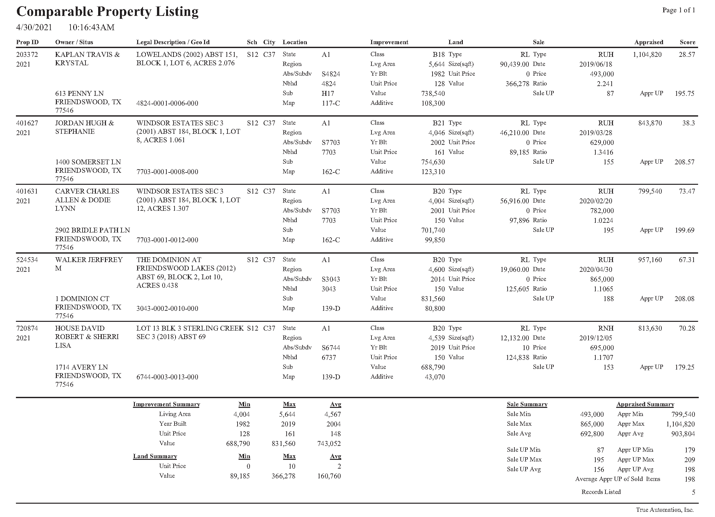
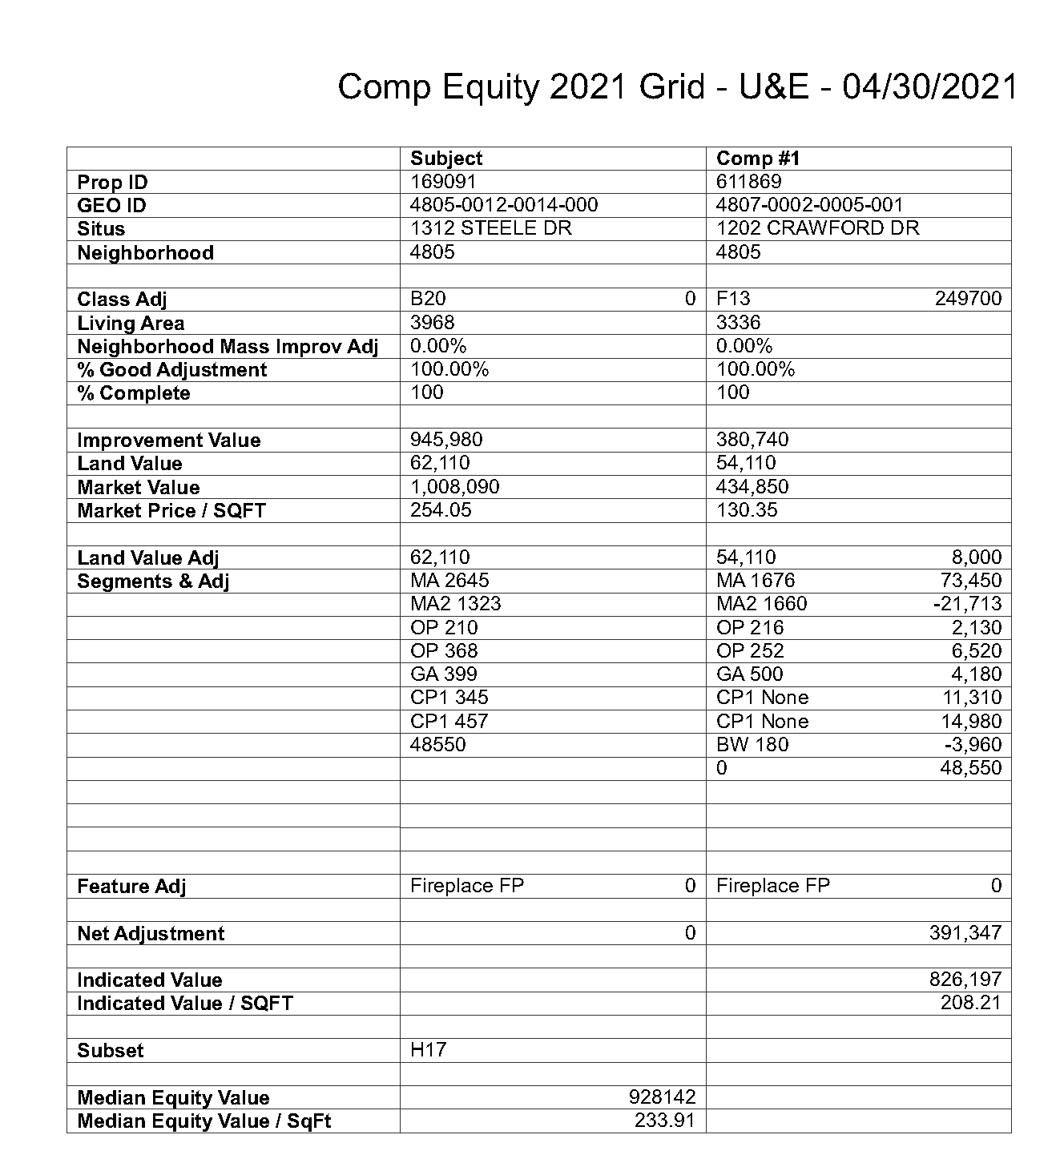
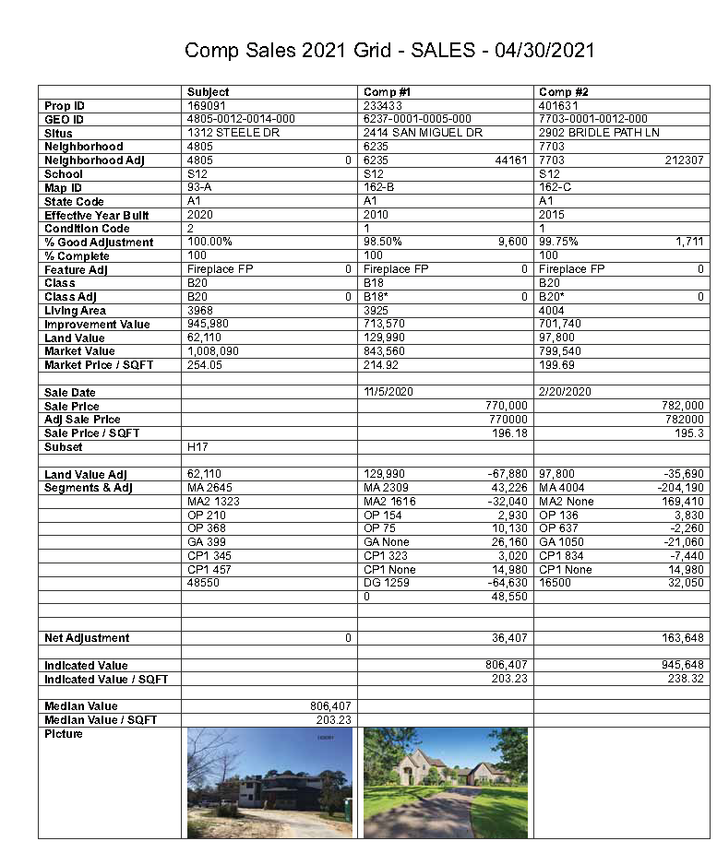
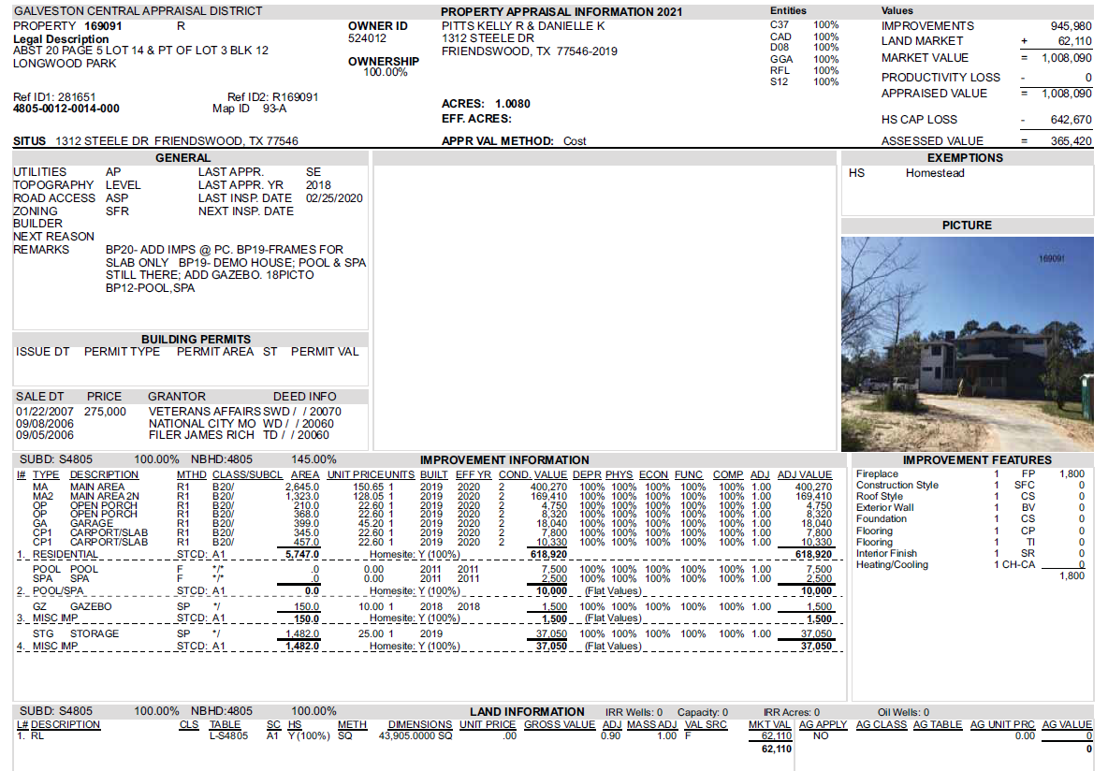
Property Record Card (like appraisal card but with photo)
All sales in your neighborhood
(NBHD SALES is actually Comp Property Listing)
Sales Comparable Property
Grid
Uniform & Equal listing of
homes in your neighborhood
(NBHD U&E)
U&E Comparable Grid

Slide 20
In the Informal Conference
You will meet with an appraiser. There should be quite a bit of discussion and sharing of information. Appraiser will make you an offer (and likely tell you that the offer is “off the table” if you go to the ARB). If you agree, you sign a waiver and go home!
If you decide to “take what you can get” note at the bottom of the waiver that although you accept the offered value – you will protest again next year!

Slide 21
Not Happy With Offer?
If not happy with outcome of informal or not ready to meet with ARB, ask to reschedule the hearing (you are legally entitled to ONE reschedule)
Complete your research and put together your evidence for the ARB
The online is the informal unless they have more evidence that we did not get before.

Slide 22
Your Evidence Packet for ARB Hearing
Bring 4 copies of the following (and any other items you have):
  page 3
  Appraisal notice
  Appraisal card of your property and comps if beneficial
  Photographs of your property
  Photographs of needed repairs and a summary of bids, receipts, insurance claims, etc.
  Map with sales, listings, foreclosures, etc.
  If taking other sales – documentation to validate
  Recent appraisal (must meet requirements)

Slide 23
The ARB Hearing
Entire process takes no more than 20 minutes
There will be 5 people at the hearing (3 ARB members, CAD employee recording the hearing and the staff appraiser)
ARB Panel Chair will start the hearing and will verify no members have talked to you, everyone will be welcomed, procedures covered (including your right to complete a survey) then everyone will be sworn in
May ask witnesses, if any, their credentials
You will be asked the nature of your protest (market or
unequal value or both - best to say you are unsure – if you
say both, you will have to prove both)

Slide 24
The CAD will present its case
You will present your case - be clear and concise (keep it short).
State why your property is different and value should be lowered.
Be persuasive not argumentative. If the CAD appraiser made an offer during the informal (or if online an amount was offered) be sure to state that at the beginning so it is part of the record
ARB may ask questions (you may too and may make a closing remark*). Remind the panel that the CAD has the burden of
proving its value by a preponderance of the evidence and if the
CAD fails to meet that standard, the protest, under Texas law
should be decided in your favor see page 3

Slide 25

The ARB will make a decision – it may reduce
the value or do nothing (it cannot increase the
value so you have nothing to lose by going through this process!)
Please complete the survey – this is the only input received by State officials

Slide 26
Other Input to Provide
If you are unhappy with the way you are treated by the ARB report it to the Taxpayer Liaison Officer (who must report
it to CAD Board and now the Comptroller)
If unhappy with the way you are treated by a CAD employee,
report it to the Chief Appraiser – via email, letter or phone.
If written, copy the Taxpayer Liaison Officer, Chairman of
the Board of Directors and me emails on page 5

Slide 27
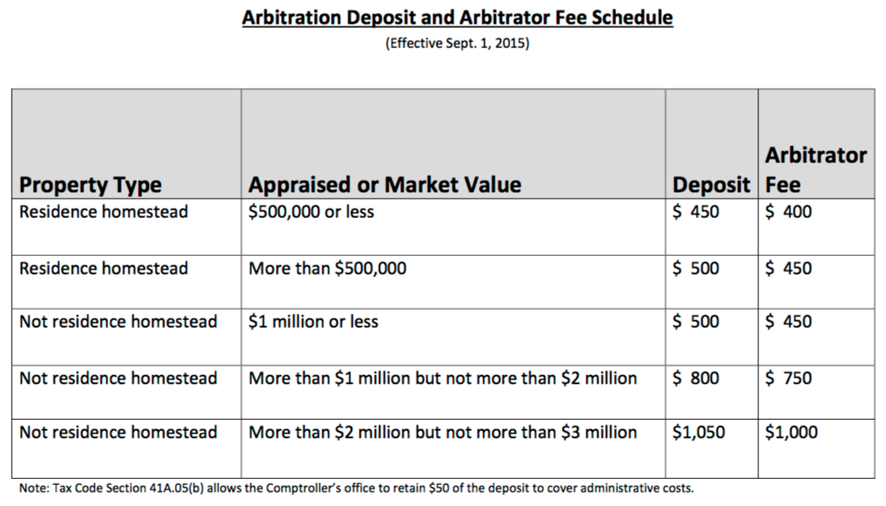
After the ARB Hearing
You will receive formal notification of the decision along with information explaining your options:
  Accept the decision
  Request binding arbitration (sliding scale but at least $450)
    An unbiased third party will hear the case in a neutral location
    Should the arbitrator’s value be closer to your value than the ARB’s, you will be refunded all but the $50 administrative fee and the CAD pays the balance (see page 4 for additional information and location of Comptroller’s online video)
  File a lawsuit in district court – these rarely go to court –
  typically mediated and agreed final judgment issued.
  Stressful but worthwhile on high end properties.

Slide 28
Other Options?
At any point in time you can hire a property tax consultant (perhaps for the ARB hearing or if you decide to proceed to arbitration). The longer you wait, the harder it will be to find one who is available!
A list is included on page 5 of the booklet (not all but these were easily found by “googling” property tax consultants)

Slide 29
Maintain a sense of humor, do not become angry, be honest & polite. Be different from the last property owner the appraiser met with!
Take chocolate!

Slide 30
FYI – Homestead Appraisal Cap
The 10% appraisal cap applies ONLY to homesteads and affects how much you will be taxed – it does NOT limit value increases (nor do ‘tax freezes’)
2023 Value of $300,000 increases in 2024 to $400,000
  2023 were taxed on $300,000
  2024 will be taxed on $300,000 + 10% or $330,000
  2025 will be taxed on $330,000 + 10% or $363,000
  2026 will be taxed on $363,000 + 10% or $399,300
  2027 will be taxed on full $400,000
  It is VERY likely that the value will increase long before you
  reach the full appraised value

Slide 31
The 2024 Protest Worksheet.xlsx
This spreadsheet is not as essential as it once was since laws changed requiring informal (and most CADs decided everyone must file formal protest in order to have an informal meeting with an appraiser. This legally entitled you to receive the sales/evidence used to value your property!
If you use it, the Instructions for the spreadsheet are in the middle of booklet (also included as tab in spreadsheet)
Data collected for unequal example was from the GCAD website

Slide 32

Good luck! Remember that YOU HAVE NOTHING TO LOSE AND A LOWER TAX BILL AS A BENEFIT IF YOU PROTEST THE VALUE!!!

Slide 33
Samuel Langhorne Clemens (Mark Twain) said:
“The only difference between a tax man
and a taxidermist is the
taxidermist leaves the skin.”
We do NOT want to skin you at the Galveston County Tax Office! We are on your side!
Information provided courtesy of
Cheryl E. Johnson, PCC, CTOP
Galveston County Tax Assessor/Collector

