Slide 1
Galveston County Safety Training
Professional Services
Welcome to New Employee Orientation

Slide 2
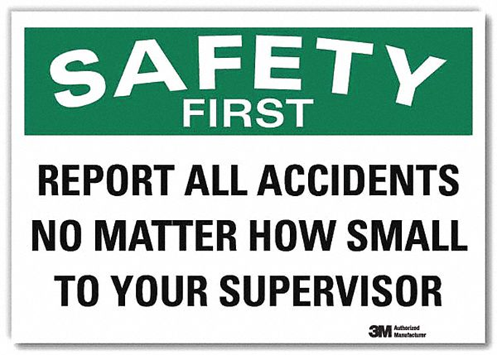
Identify Safety Hazards
Your Role In Safety
Maintain a safety attitude
Stay Alert! Keep your eyes open for safety hazards and near misses
Fix what you can, report what you can’t fix
Ask for help!
Suggest ideas for safety improvement
Galveston County’s goal is an accident-free workplace.

Slide 3
Reporting Accidents and Injuries
Accidents and injuries must be reported to your Supervisor immediately.
If medical attention is required, the injured person will be taken to:
West Isle (island)
Well Now Clinic (mainland)
If medical treatment is refused by an injured employee, but they experience pain later that day or night, contact Human Resources who will make arrangements for treatment at the nearest clinic.
Serious injuries will be sent to the nearest Emergency Room.
West Isle Urgent Care
2027 61st Street
Galveston, TX. 77551
409-744-9800
Hours: 8:00 am – 10:00 pm 7 days per week.
Well Now Health
676 FM 517 West
Dickinson, Texas 77539
409-572-2535
Hours: M-F 8:00 am – 7:00 pm
Saturday: 9:00 am – 2:00 pm
Sunday: 12:00 pm – 4:00 pm

Slide 4
General Safety Rules
OBEY all warning signs
FOLLOW all safety procedures
DO NOT take shortcuts
DO NOT engage in horseplay

Slide 5
Safety Statistics
A worker is injured on the job every 7 seconds. (540/hour 12,900/day)
An average of 5,000 fatal accidents per year in the past 5 years.
Most accidents occur in the first 6 months of new employee.
OSHA’s Fatal Four:
Falls
Electrocution
Caught in or between objects (trench collapse, pinch points)
Getting struck by an object (vehicles, falling objects)
*U.S. Bureau of Labor Statistics https://www.bls.gov/iif/home.htm
*Occupational Safety and Health Administration https://www.osha.gov/data/commonstats

Slide 6
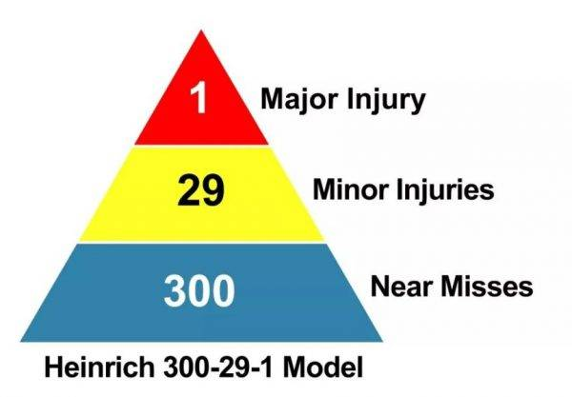
Hazard Vs. Near Miss
Hazard: Any Practices or conditions that can cause injury, illness, or death to workers or damage to work environment.
Spills, tripping hazards, or blocked aisles
Electrical or improper wiring
Workplace bullying or acts of violence
Near Miss: situations where an accident or injury is narrowly avoided. But has potential for future hazard if
A worker slips, trips or falls without injury
A worker can’t see properly due to a burned out lightbulb and trips over something

Slide 7
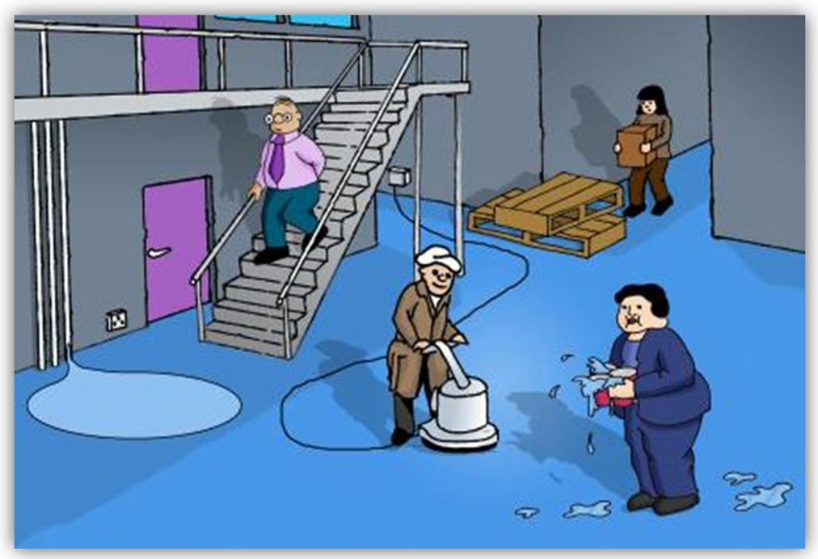
When you ignore safety hazards, you ignore the safety of others.
How many near misses can you find in the picture?
Trick Question! These are ALL Hazards!

Slide 8
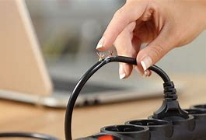
Electrical Hazards
DO
DON’T
Use plugs that fit the outlet
Check wire and cord insulation
Make sure electrical connections are tight
Keep flammables away from outlets
Keep clear access to electrical boxes
Overload outlets
Fasten cords with staples, nails
Run cords through water or touch cords with wet hands
Use damaged cords
Use ungrounded cords or remove grounding prong from a three-pronged plug

Slide 9
Fire Hazards
Fire Hazards In the Workplace
Electrical Fires
Faulty or poorly installed electrical equipment
Don’t overload power sockets
Heat Generating Objects
Continuous use of electrical equipment and machinery
Clutter
Piles of paperwork, box of files, overflowing garbage bins
Blocked fire exits
Flammable Liquids & Gas
Cleaning fluids, paint thinners, waxes and polishes
Human Error & Negligence
Improper use of equipment, accidents, spilt drinks over electricals, leaving cooking unattended

Slide 10
Fire Response
Ensure everyone has left, or is leaving the building
Have an unobstructed escape route
Notify the fire department
Know how to use the fire extinguisher
-When an emergency occurs, notify supervisor immediately -Know evacuation meeting area (primary & secondary locations) -If you evacuate with another department, ensure your supervisor is aware that you are safe.

Slide 11
Slips, Trips & Falls
Power cords, ropes, hoses across the floors and walkways
Obstructions
Area Lighting
Clutter in walkways
Wet floors/Spillages
It is the second to motor vehicle accidents as the most common cause of accidental deaths.
Slip and fall injuries have nothing to do with someone’s clumsiness, but they have everything to do with someone’s negligence.

Slide 12
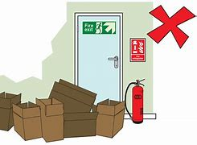
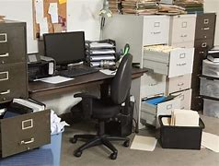
Good Housekeeping
Keep clear access to evacuation routes, emergency exits, fire-fighting equipment and first-aid stations, and electrical panels
Keep walkways and stairwells clear
Close drawers and file cabinets
Dispose of trash promptly and properly

Slide 13
Ladder Safety
All ladders must be inspected prior to each use. Those found to be unserviceable shall be removed from service immediately.
Ensure only light work is carried out on the ladder where tools can be operated safely with one hand.
Make sure that no one works underneath the ladder.
Do NOT straddle the ladder.
Do NOT lean the ladder against the wall.

Slide 14
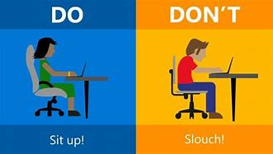
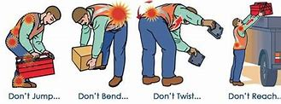
Ergonomics -Prevents musculoskeletal disorders
DO
DON’T
Slouch or slump
Use awkward positions
Use wrong tools for tasks
Overreach/stretch for items
Adjust your workspace
Use a neutral position
Take assigned breaks
Do exercises
Breathing Exercises

Slide 15
Back Safety
Assess the situation
Can you lift this load safely, or is it a two-person lift?
How far will you have to carry the load?
Size up the load
Test the weight by lifting one of the corners. If too heavy or awkward shape, stop!
Lift safely
Bend at knees
Pull load close to body
Face your load-don’t twist your body
Let legs do lifting by standing with back straight
Carrying the load
Change direction by turning your feet, not your back.
Your nose and toes should always be pointing in the same direction.
Use hand trucks, pushcarts, forklifts
Push rather than pull-use both hands
Use tie-downs to secure the load
Obtain training and authorization before using a forklift

Slide 16
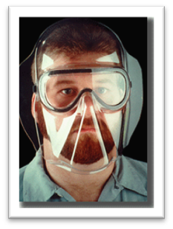
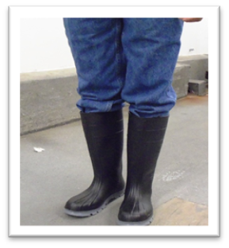
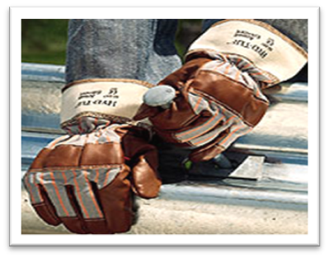
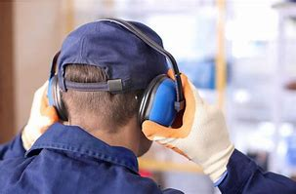
Personal Protective Equipment
General PPE Requirements
Foot wear
Head Protection
Hearing Protection
Hand Protection
Face/Eye Protection
Respiratory

Slide 17
Chemical or Hazardous Substance Spill
Minor Spill
Major Spill
Must be 2 gallons or less of spilled substance
Alert people in the immediate area of the spill
Do NOT clean up spill if you do not know the hazards
Immediately contact supervisor
Increase ventilation and wear necessary PPE
Over 2 gallons, very hazardous or unknown substances
Class 1 flammable solvents
Hydrochloric/Nitric Acid
Propane spills
Immediately call 911 and notify supervisor
Alert everyone to evacuate

Slide 18
Blood Borne Pathogens Use extra caution (PPE) when providing CPR/First Aid or working around blood borne pathogens Ask immediate supervisor where the designated kits are located.
Examples of Diseases:
Human Immunodeficiency Virus (HIV)
Hepatitis B (HBV), C (HBC)
Syphilis
Malaria
How it is transmitted:
Blood
Saliva, vomit, urine
Bodily secretions
Skin, tissue, cell cultures
What to do if exposed?
Clean exposed area with soap and water; skin disinfectant if available.
Flush splashes to the eyes, nose, mouth, or skin with water, saline, or sterile wash.
Report exposure to your supervisor
Seek immediate medical attention and follow up care.

Slide 19
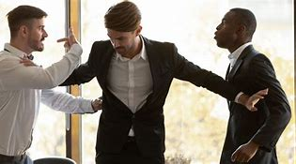
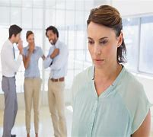
What is workplace violence?
Workplace violence is any act or threat of physical violence, harassment, intimidation, or other threatening disruptive behavior that occurs at the work site. It can affect and involve employees, clients, customers and visitors.
Bullying
Verbal abuse
Physical assaults and even homicide
Workplace Violence

Slide 20
Workplace Violence
Recognize The Signs
Noticeable shifts in behavior or performance
Abnormal. Drastic or risky behavior/moods
Intentionally violating company policies
Major change to personal circumstance
Loss of income or loss of a loved one
Decreased concern for personal hygiene
Drug or alcohol abuse
Seeking vengeance for perceived wrongdoings
Reacting violently or dramatically to company changes
Making statements about getting revenge or punishing others
Empathy for those who have committed similar crimes/violence

Slide 21
Notes:
Run: Leave your belongings behind. Evacuate regardless of whether other agree to follow. Do not attempt to move wounded people.
Hide: Silence your cell phone! Turn off any source of noise. Remain Quiet!
Fight: Only when your life is in immenent danger. Attempt to disrupt and/or incapacitate the active shooter (throw items, yell)

Slide 22
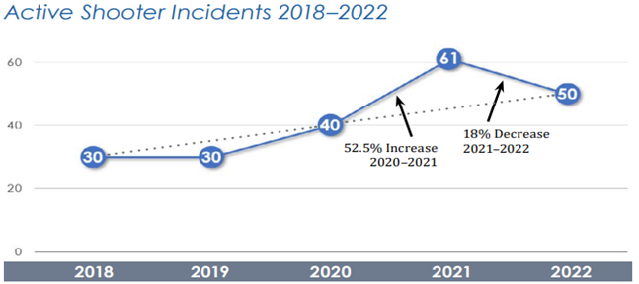
Active Shooter Safety
How To Respond When Law Enforcement Arrives
Information To Provide To Law Enforcement
Remain calm, and follow officers’ instructions
Put down any items in your hands (bags, jackets)
Immediately raise hands and spread fingers
Keep hands visible at all times
Avoid making quick movements toward officers
Avoid pointing, screaming or yelling
Location of the active shooter
Number of shooters
Physical description of shooter
Number and type of weapons
Number of potential victims at the location
Active Shooter Incidents in the United States in 2022 — FBI

Slide 23
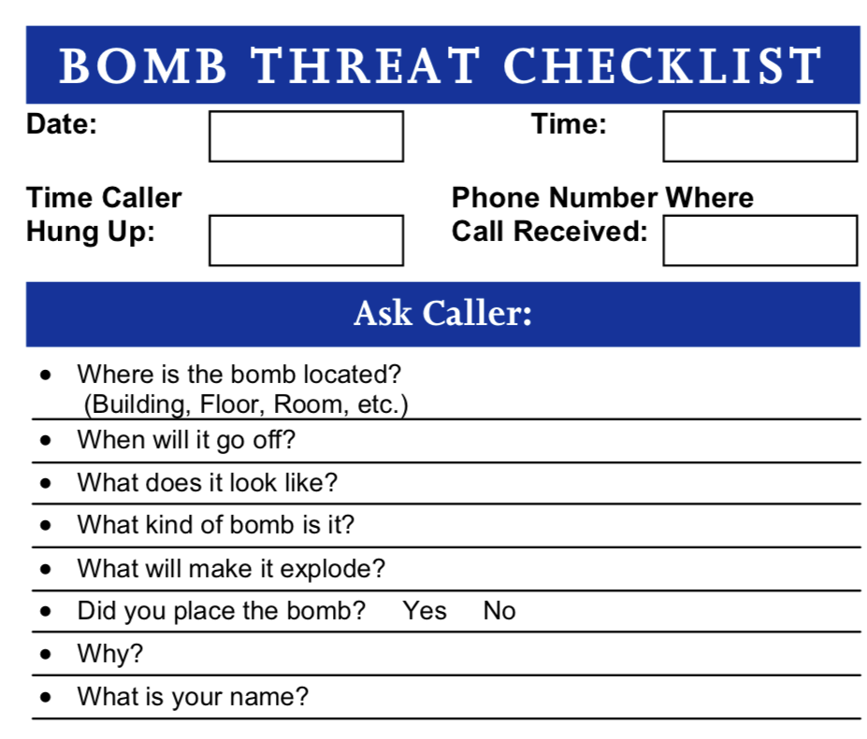
Bomb Threat Safety
An employee who discovers a suspicious package or container, or receives a verbal or written bomb threat, must immediately alert a supervisor and call 911.
Secure the area around the suspicious object so that no one can disturb it.

Slide 24
Floods, Hurricanes & Earthquakes
Know What to Expect
Have A Plan!
Know your area’s flood risk.
Ask immediate supervisor if you are not familiar.
If it has been raining for several hours or days, be alert to the possibility of a flood.
Plan
Home, work, school
Identify safe areas
Have a disaster kit
Know how to stay weather aware
Monitor
Weather watcher
Listen to local radio and TV stations
Act
When severe weather threatens

Slide 25
COVID-19 Safety
Wash your hands frequently.
Use alcohol-based hand sanitizer.
Avoid touching your eyes, nose, and mouth.
Cough or sneeze into a tissue or your elbow.
Clean and disinfect frequently touched objects and surfaces such as cell phones.
Stay home when you are sick.
Be prepared if your child’s school, daycare facility, or your worksite is temporarily closed.

Slide 26
Thank You
Professional Services
Welcome to the County!

