Slide 1
Welcome to
Judge’s Training
Notes:
85.005 Feb 21st is a legal holiday so there will be no voting

Slide 2
Important Updates
Designated Curbside Parking requirements and signage
Updated Voter Priority and signage
The State has added a new form Register of Surrendered Ballots by Mail

Slide 3
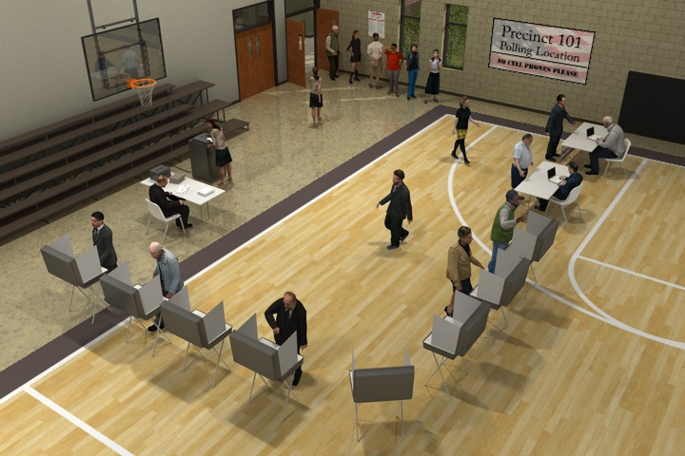
Setting Up
Judges, plan the layout.
Consider:
  ADA compliance
  Traffic flow & privacy
  Public access & notifications

Slide 4
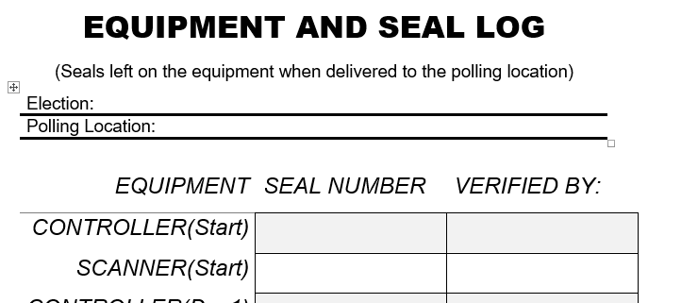
Equipment Set Up
Judge will verify Equipment & Seal Log.
Controller and Scanner must be sealed each night during Early Voting.
The Verity Duos do not need to be sealed every night.
Notes:
Controller and Scanner must be locked and sealed every night. Broken seals will be kept with the seal log.

Slide 5
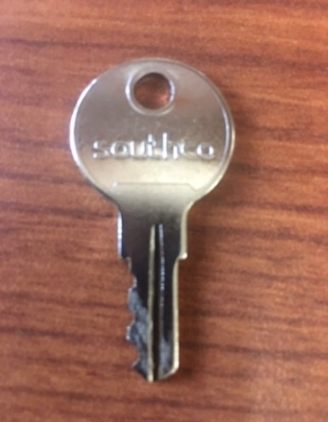
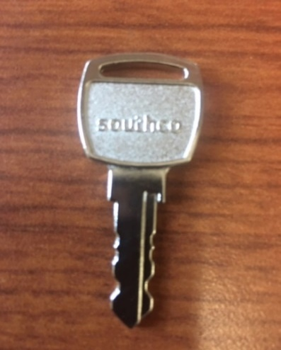
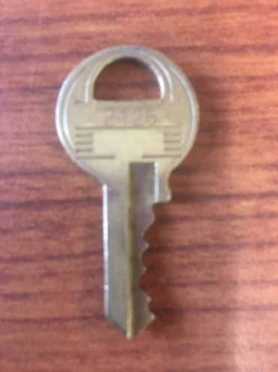
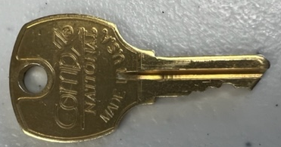
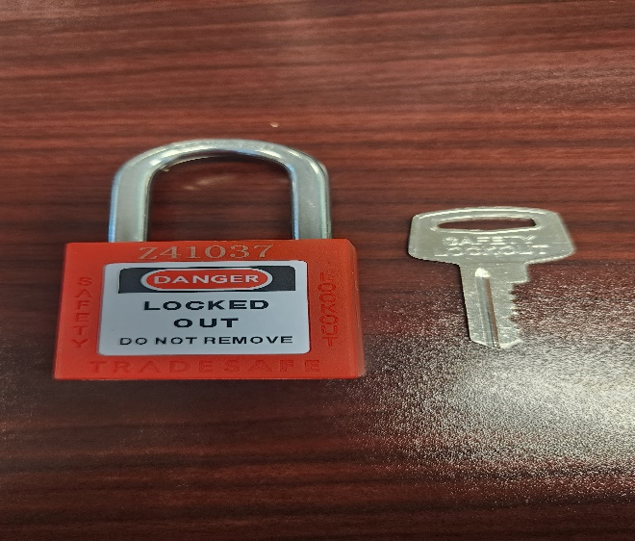
The Judges Keys and Locks
“R” Key operates the tablet lock
“Square Key” unlocks the outside lock on equipment cases
Round Brass Key unlocks the rack
Brass “CompX” key is for the scanner box
You will also receive a set of locks and a key. The JUDGES LOCK will be the red lock and key that says “Safety Lockout” shown to the left. The deputy’s lock is the large master lock which they will have the key for. At the end of the night the clasp will be placed on the ballot bag with the 2 locks securing the clasp.
Notes:
There is two other locks on the scanner box 1 is from the deputy and 1 is from our office.

Slide 6
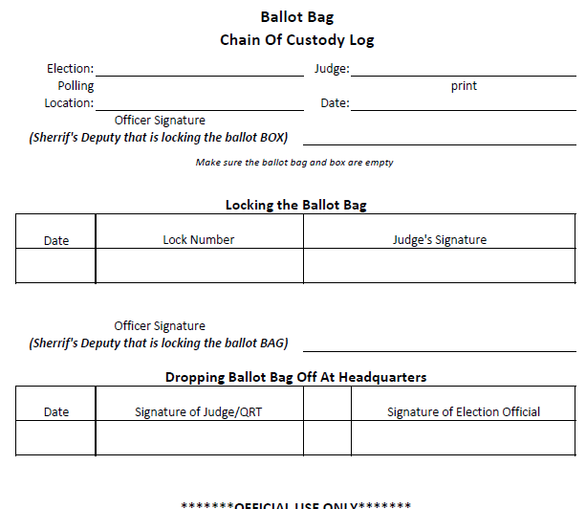
Ballot Bag Chain of Custody
5
The top portion of this form will be filled out with a Deputy, when locking the ballot box on the first day of Early Voting or Election Day.
The second portion will be filled out with a Deputy, at the end of EV or ED when the judge and Deputy unlock the ballot box and lock the grey ballot bag.
The Third portion is filled out at equipment drop off with election staff.
Keep this form in the clear slot on the top of the grey ballot bag
2023 Entity Election
Jon Snow
Justice Center
May 6, 2023
Officer Andy Taylor
Filled out when locking the ballot box/ beginning of EV/ED
This part is filled out at the end of EV or ED
4/24/23
12345
Judge Judy
Officer Andy Taylor
Filled out at equipment drop off
5/2/23
Judge Judy
Elections staff

Slide 7
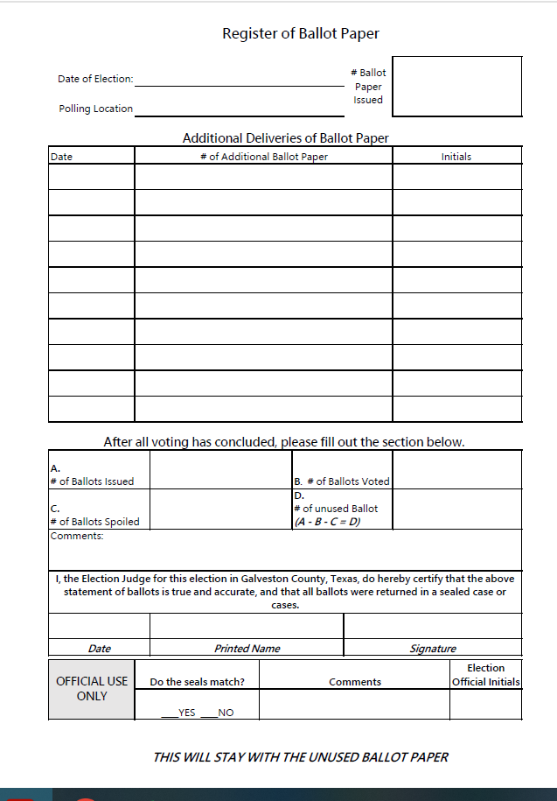
Register of Ballot Paper
6
Record every new delivery of ballot paper.
The paper is in sets of 100 in sealed manila envelopes. All unsealed paper will have to be counted individually, so we suggest NOT opening more than 1 pack of paper.
Keep the Register of Ballot Paper in the clear slot on top of the grey unused ballot paper bag.
If there is any discrepancies in totals add to the comments
2214448
4/24/23
1000
Justice Center
500
JJ
(1000+500)
1200
You can find this number on the controller
10
290

Slide 8
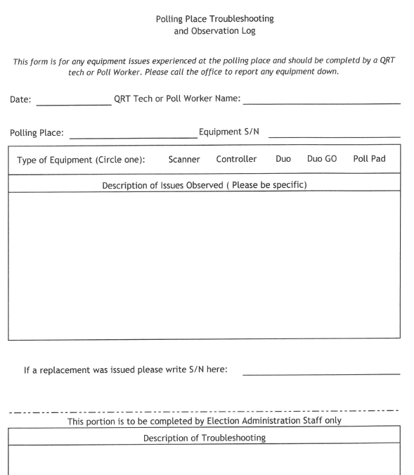
Equipment Troubleshooting Log
This form is for tracking equipment issues in the polling place. Always call the office to let us know what issues you are having so that we can fix and follow up with them.
Please be as specific as possible with the issues you observed.
Always tape this form to the outside of the equipment so we know to follow up on the issue.
Judge Judy
Justice Center
B1254545436
Received an error message that said XYZ
Or the printer would not feed any paper through

Slide 9
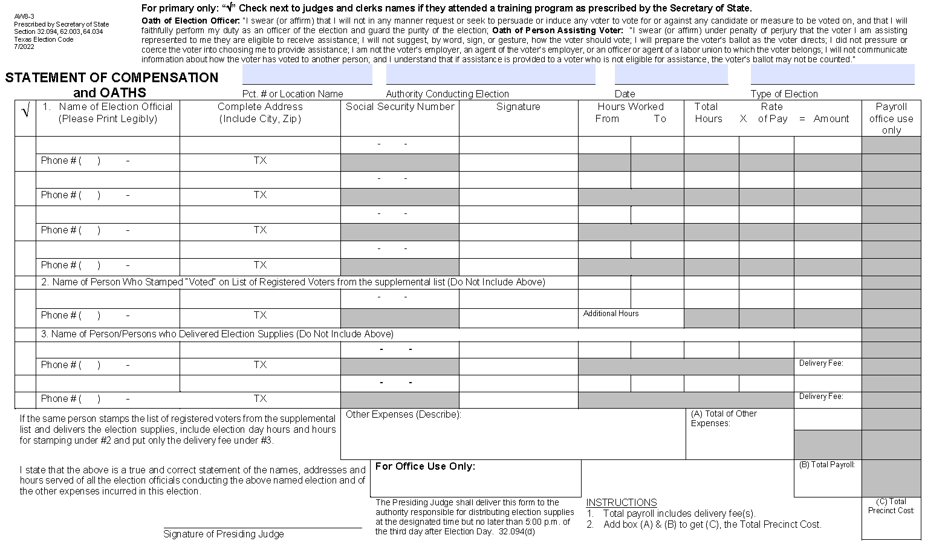
Opening the Polls
Judges’ Preliminary Paperwork
  Election Day Compensation Form (Please print neatly!)
West County Annex
Galveston County
11/08/2022
General
Tommy Turnbow
1234 West Dr, League City, 77573
000 00 0000
Tommy Turnbow
7:00 AM
7:30 PM
12.5
Judge Hill
Notes:
Please fill these out completely and as neatly as possible. Make sure that your workers read this oath.

Slide 10
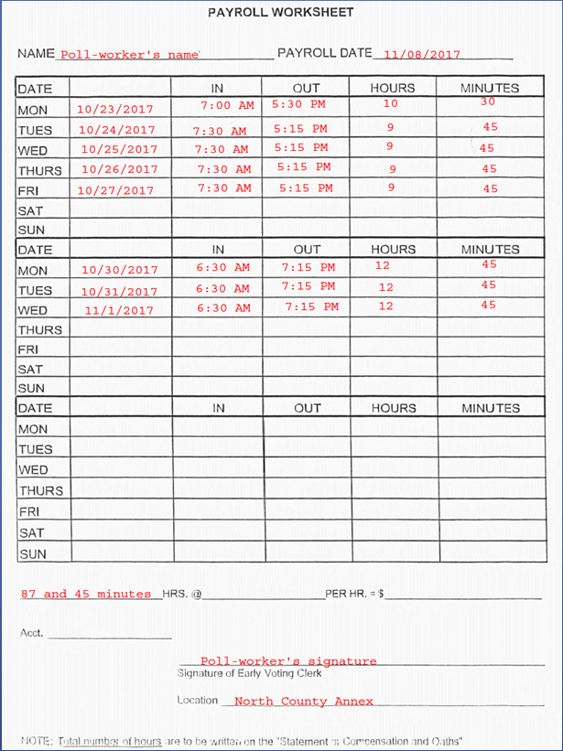
Opening the Polls
Judges’ Preliminary Paperwork
  Early Voting time sheets (See sample in tote)
Notes:
Please fill these out like the sample is done. Each early voting worker fills this out.

Slide 11
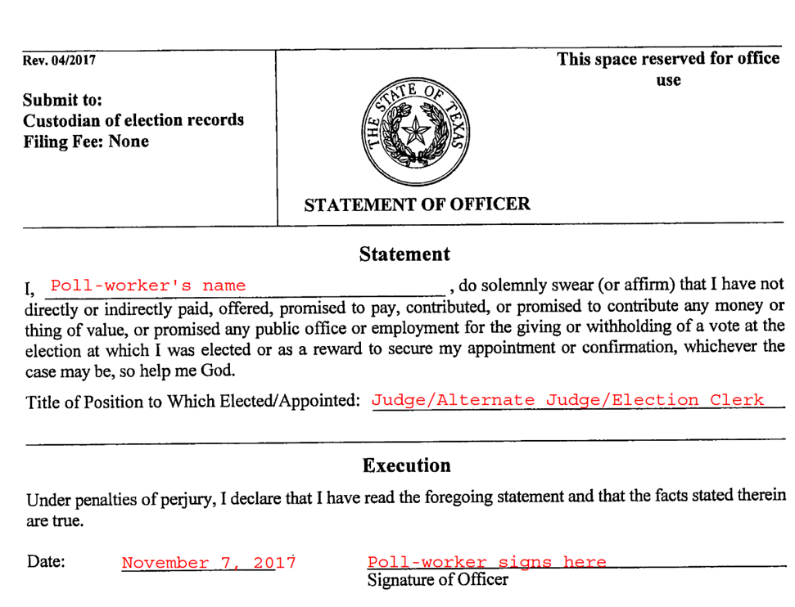
Opening the Polls
Judges’ Preliminary Paperwork
  Statement of Officer to be filled out before the Oath of Office.
Notes:
Give this oath to the judges so they can give it to their clerks

Slide 12
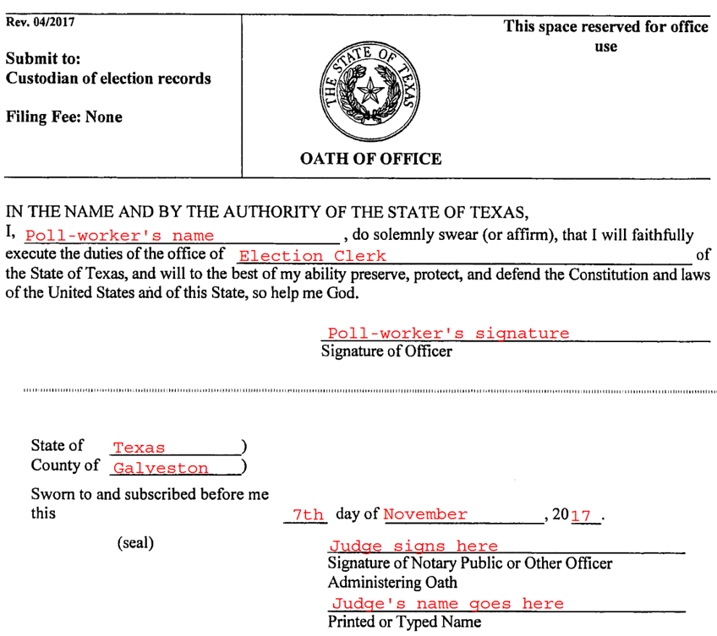
Opening the Polls
Judges’ Preliminary Paperwork
  Oath of Office (Not the same as the oath on the Compensation form.)
Notes:
This is what the judge gives to their workers ( good for ev and ed)

Slide 13
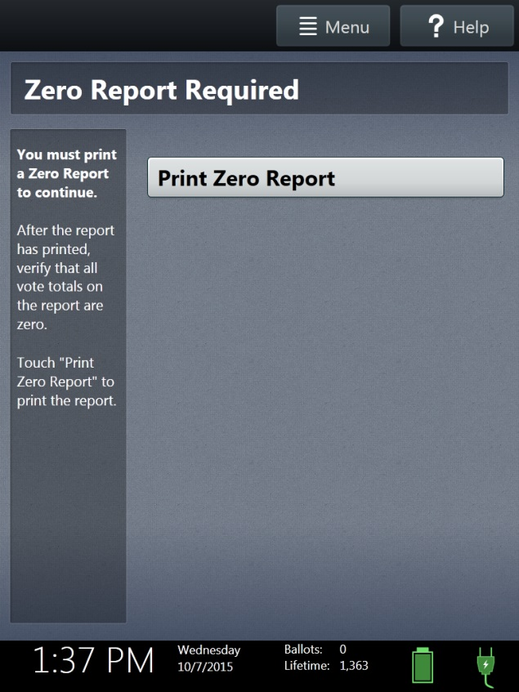
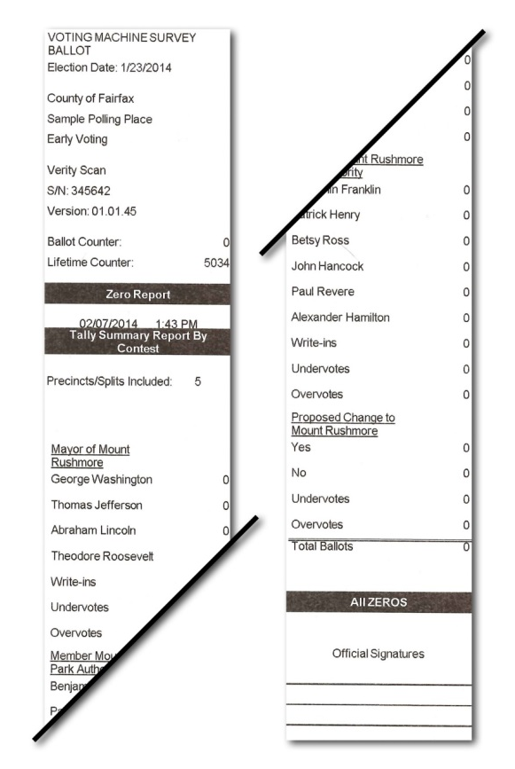
Opening the Polls
Zero Report
  Screen appears on first day of Early Voting and Election Day.
  Zero Report must be printed in order to open the polls.
  Verify:
    Polling Place
    Ballot Counter total = 0
  Judges will sign and file the zero report in the envelope returning to the Elections Office.
  File the “Zero Report” and Daily reports in the yellow envelope
Notes:
61.002 Must print and sign for open and closed polls

Slide 14
Opening the Polls
Have polls open ½ hour before official time.
Call the Elections office at:
Do not vote anyone until Official Polls Open time.
Make sure you have hours ready
(409)770-5108
Notes:
Check the time on your controller. IF it is not right call elections

Slide 15
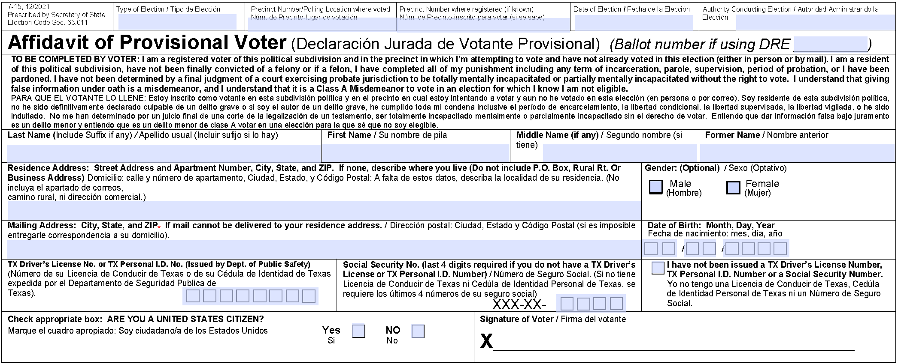
Processing Provisionals
Voter completes the front of the envelope.
Judge should always call the office to verify that the voter should be voting provisionally
At least one must be filled out!
Cruse
Muriel
Jean
3422 Oak Drive, Dickinson, TX 77539
0
7
2
5
1
9
6
4
1
2
3
4
Muriel Jean Cruse
Notes:
Please ask the voter to try and make sure that this is legible. There will be one provisional bag per location.

Slide 16
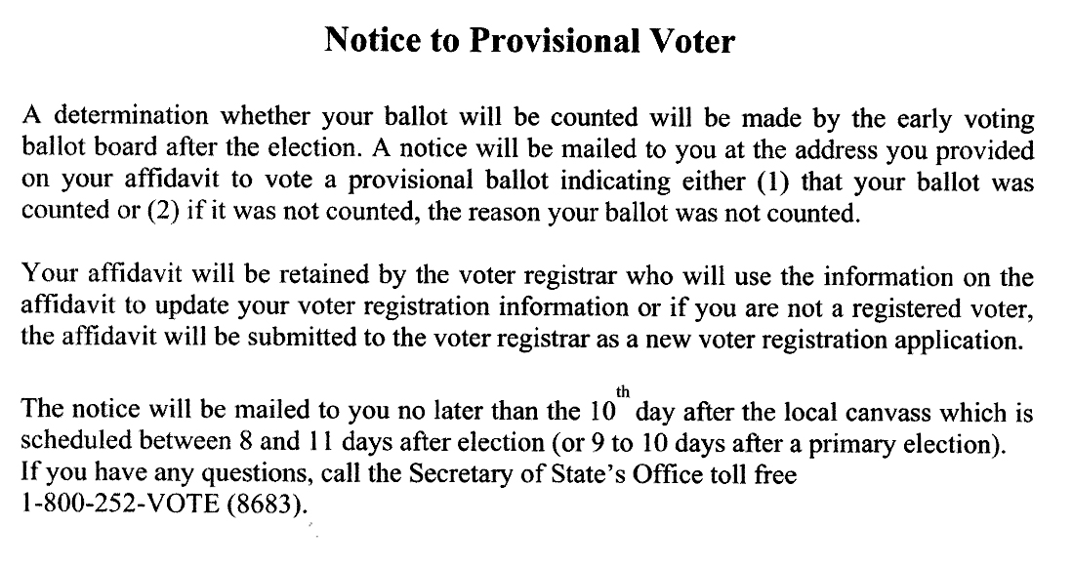
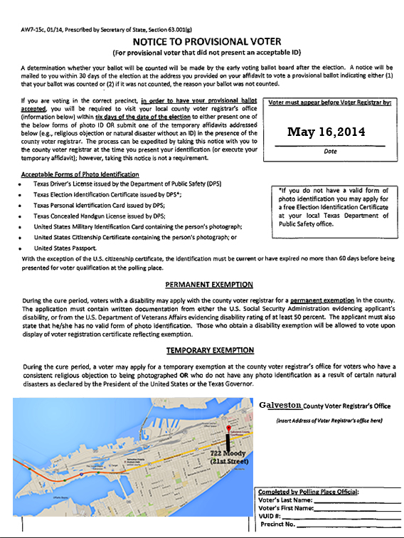
Processing Provisionals
Judge gives voter appropriate Notice.
All Other Provisional Voters
No Acceptable ID
Notes:
These form might change but will be very similar

Slide 17
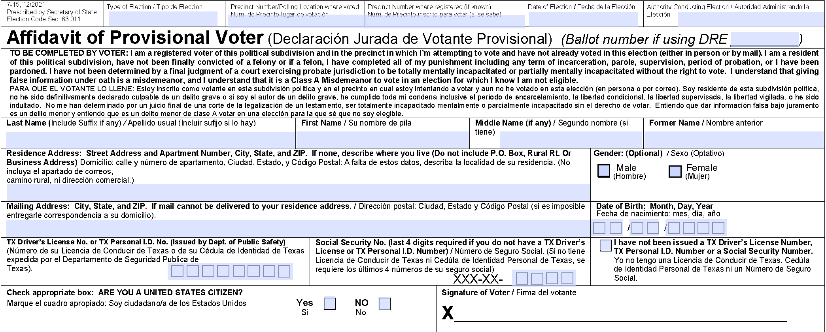
Processing Provisionals
Judge completes top of envelope. It is very important that the polling location and voter’s precinct are filled out.
General
La Marque CC
220
Nov. 8, 2022
Galveston County

Slide 18
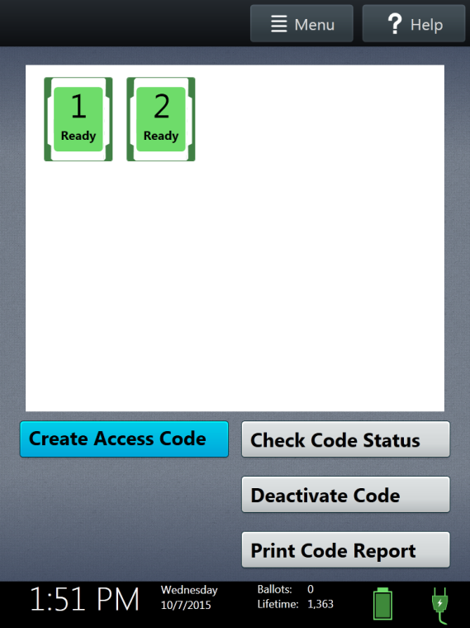
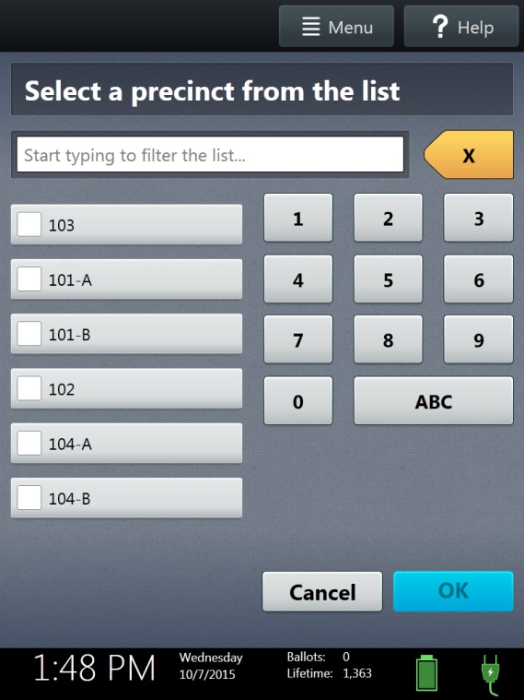
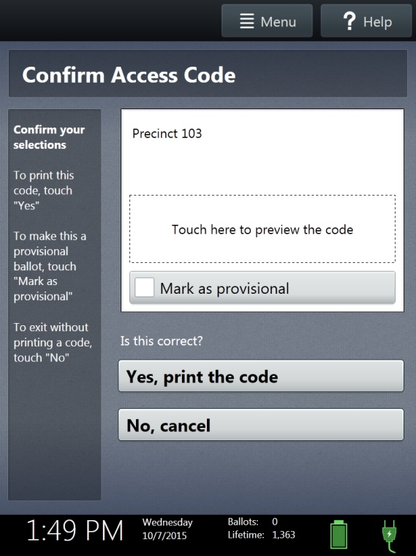
Processing Provisionals
Judge will manually Create Access Code.
Choose Precinct and Ballot Style.
Touch “Mark as provisional.”
Touch “Yes, print the code.”

Slide 19
Processing Provisionals – Things to Remember
Always call the Elections office to verify the voter is supposed to vote provisional.
When processing the voter on the poll pad, always check the box for provisional on the confirmation page.

Slide 20
Processing Provisionals
Paper for PVR must be given to the voter, along with the access code.
This sheet, once marked with the “Printed Vote Record,” will be placed inside the secrecy envelope along with the lower portion of the access code slip.

Slide 21
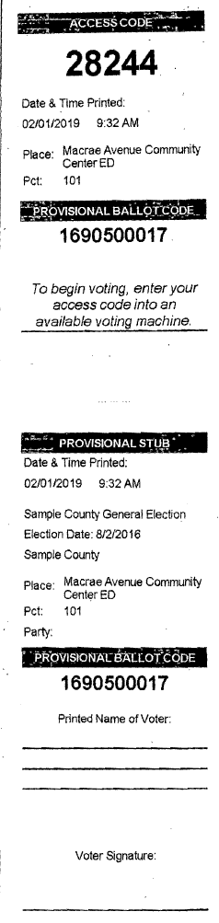
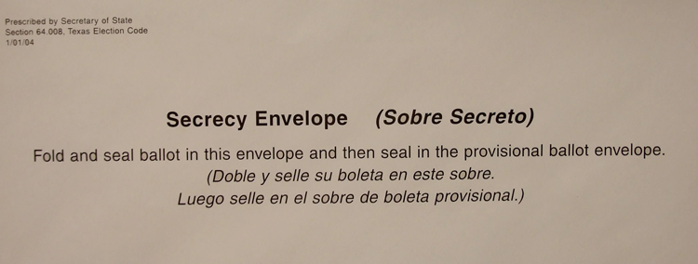

Processing Provisionals
Voter Uses Access Code to Vote
Tear off top part.
Voter signs bottom.
Voter seals slip in the secrecy envelope.
Voter seals secrecy envelope in provisional envelope.

Slide 22
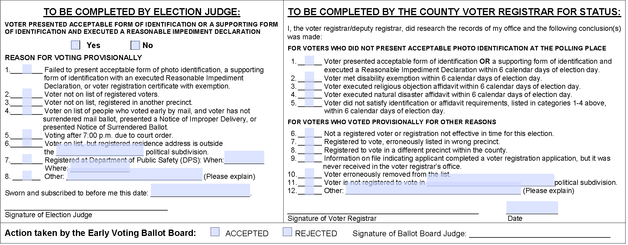
Processing Provisionals
Judge should complete back of Provisional Envelope.
X
X
07/25/2022
November 8, 2022
Judge Sam Hill
Notes:
Make certain the back of the envelope is complete! Do not write on the right side.

Slide 23
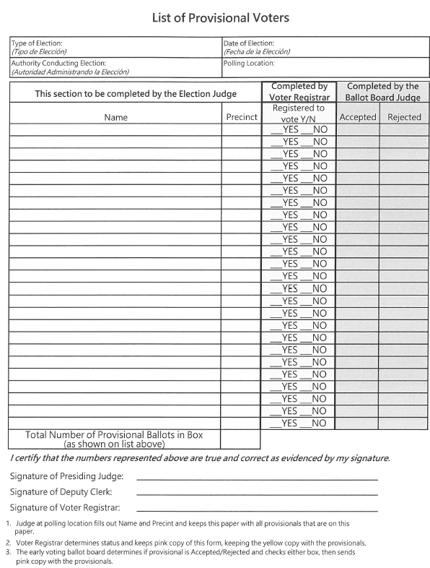
Processing Provisionals
Judge should immediately enter the voter on the List of Provisional Voters.
Entity
Justice Center
Galveston County
May 6, 2023
Joe Hill
237
Judge Jon Snow
Notes:
We double check all of the Provisional's from this list. Please make sure that you fill it out one copy goes in provisional bag and you keep one

Slide 24
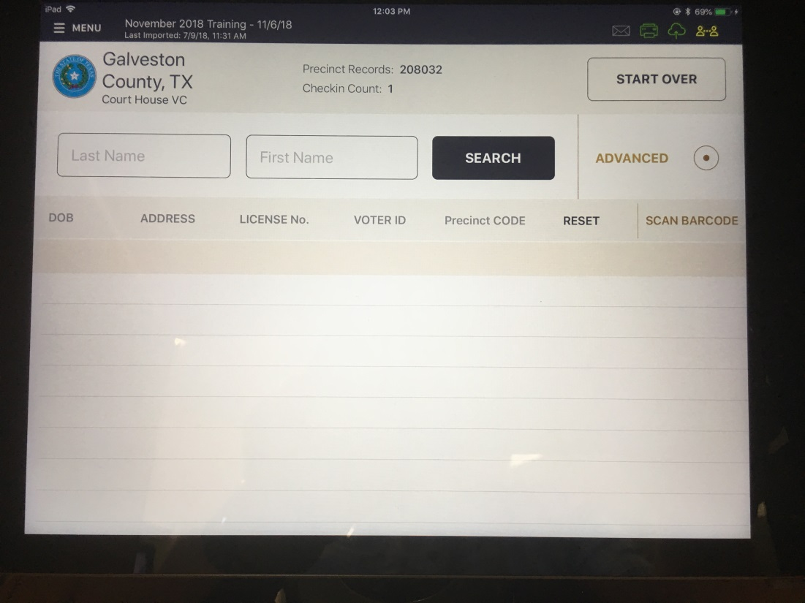
Special Circumstances
Steps to follow in order if voter is not found:
  Try a manual entry if barcode scan was used.
  Check data.
  Touch advanced button.
  Search on DOB, License No., or Voter ID.
  Always call Elections Division if voter is not found.

Slide 25
Is the voter in the poll pad?
YES
Start Here
NO
Do they have proper identification with them?
Are they registered in Galveston County? CALL TO VERIFY
YES
NO
YES
NO
Are they in Suspense?
Do they own a list “A” identification?
Follow the “ADD VOTER” Process and issue regular ballot.
NO
YES
YES
NO
Issue a regular ballot.
They can vote a PROVISIONAL BALLOT OR come back with the proper Identification.
Are they a registered voter in the state of Texas? CALL TO VERIFY
NO
YES
Do they still live in Galveston County?
They can vote a regular ballot if they have the proper list “B” Identification AND FILL OUT A REASONABLE INPEDIMENT FORM
If they insist on voting, they will vote a PROVISIONAL BALLOT
NO
YES
They should voted in the county they live in. Offer a PROVISIONAL BALLOT if they insist on voting here.
They will fill out a STATEMENT OF RESIDENCE and vote in their CURRENT PRECINCT.
During Early Voting ONLY, they can vote a LIMITED BALLOT at the main Early Voting location at the JUSTICE CENTER in Galveston. On Election Day offer a PROVISIONIAL BALLOT.

Slide 26
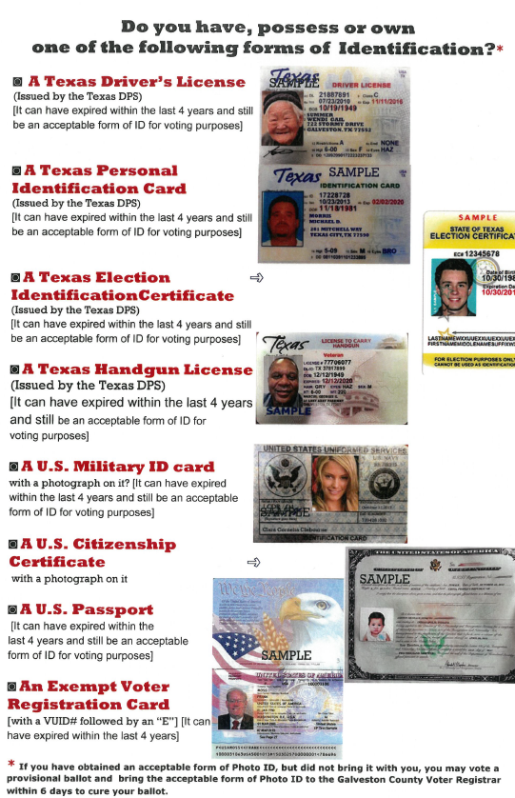
Special Circumstances
Voter does not present valid photo ID.
Clerk should show the voter the laminated list “A” of acceptable photo IDs.
    Must have a photo.
    Must have an address (not necessarily current).
    Expiration date must be within four years (Except voters 70+ years of age)

Slide 27
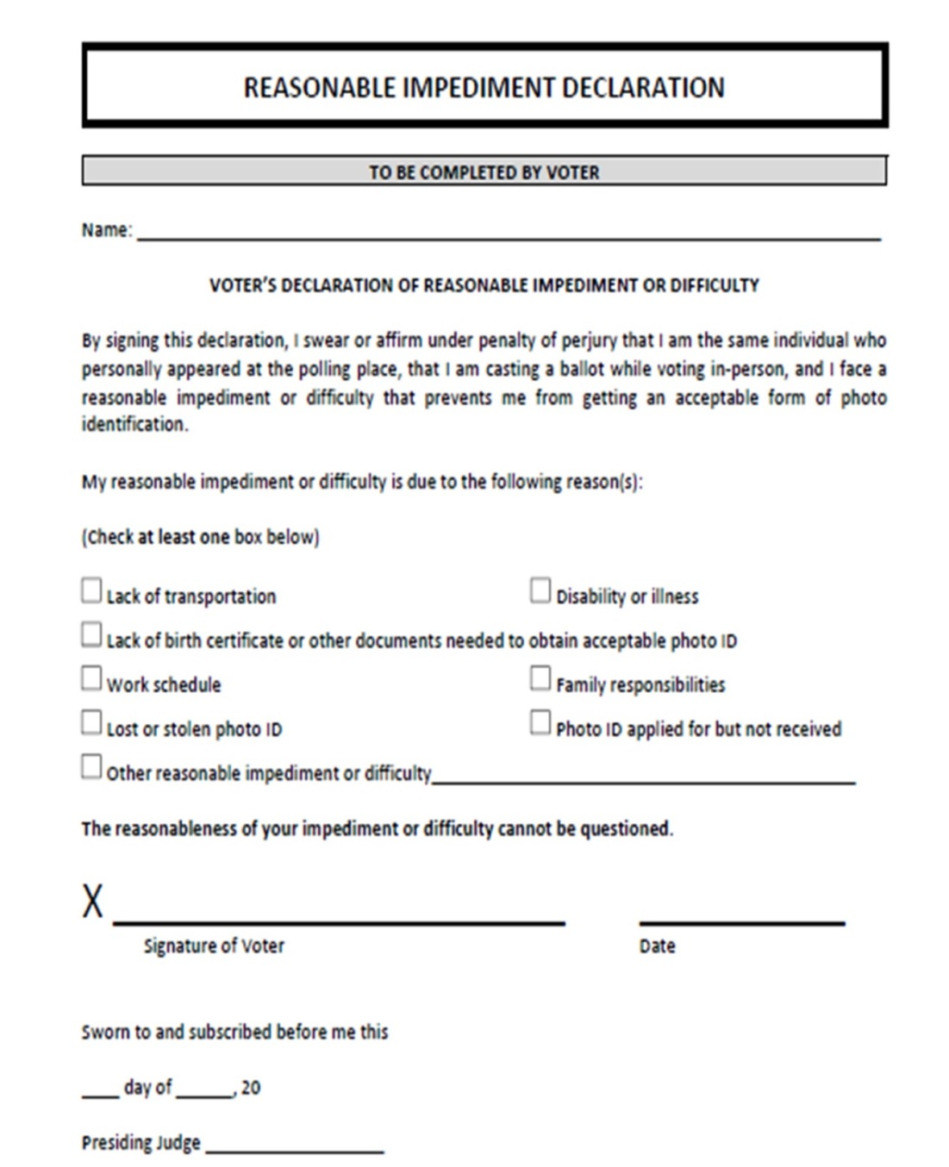
Reasonable Impediments
These are NOT for those who already possess a valid photo ID.
Impediment voters must first present supporting documentation in the voter’s name.
Voter must complete the Reasonable Impediment Declaration.
Gloria H. Voter
✓
Gloria H. Voter
03/01/2022
Must be signed by both the voter and the judge.
21
Feb
22
Judge Sam Hill

Slide 28
Reasonable Impediment
List “B”
Certified birth certificate.
Valid voter registration certificate.
Copy or original of:
  Current utility bill. (<60 days)
  Bank statement.
  Government check.
  Pay check.
  Other supporting “Government Documents:”
  Driver’s License from another state
  (It doesn’t matter if it has expired!).
  ID card issued by federally recognized Native American tribes.
  DPS receipt for DL/ID card without photos.
  Expired Voter Registration Card.
  Texas driver’s license or personal ID that expired over four years ago.
  These Documents will only be used with a Reasonable Impediment
All supporting documents must be in the voter’s name!

Slide 29
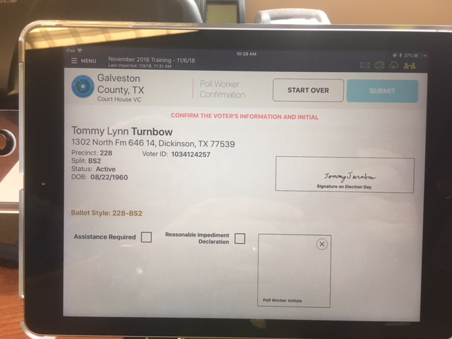
Important Points
Reasonable Impediment voters will vote regularly.
Provisional voters are not impediment voters and vice-versa.
Please return all impediment forms in manila envelope #2 (Yellow).
Tick the check-box for impediment form on the poll pad.

Slide 30
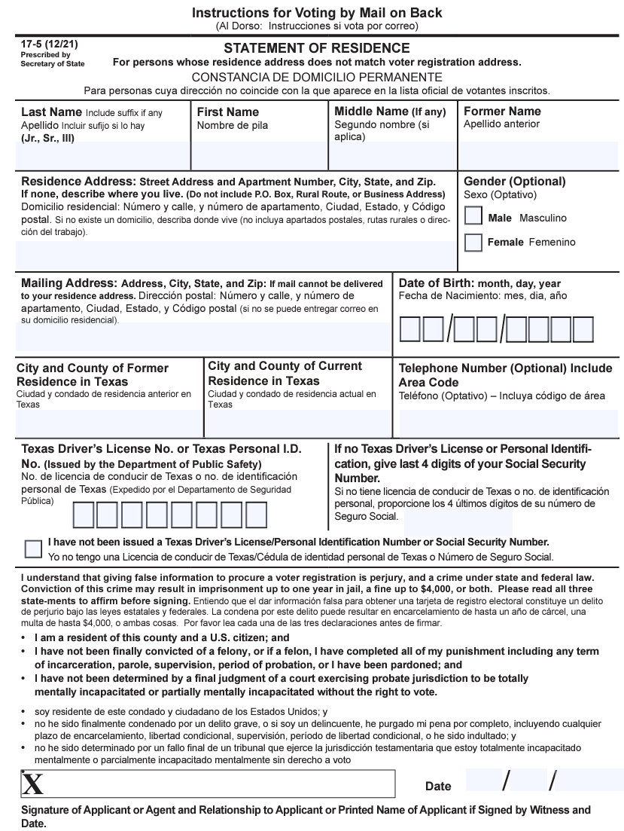
Special Circumstances
Voter has moved.
  General rule = Voters vote where they live.
  If they move within Galveston County:
    Verify that they moved within the past 30 days.
    Obtain a Statement of Residence.
    Voter votes in the old precinct.
    -OR- Voter votes provisionally in the new precinct.
Aldame Raquel
589 Float Away Drive, Tiki Island 77554
P.O. Box 471, Tiki Island 77554
0 9 0 5 1 9 4 0
Houston, Harris
Tiki Island, Galveston
9 6 4 80 2 1 0
Raquel Aldame 11 7 17

Slide 31
Special Circumstances
If Voter has moved from another county within Texas:
  During Early Voting, the voter may appear at the Elections Office (Justice Center) and vote a Limited Ballot.
  Otherwise, the voter will vote provisionally.
If the Poll Pad shows a voter is in Suspense:
  the voter MUST FILL OUT A STATEMENT OF RESIDENCE before casting a regular ballot.
  Otherwise the voter must vote provisionally.
Notes:
Only early voting

Slide 32
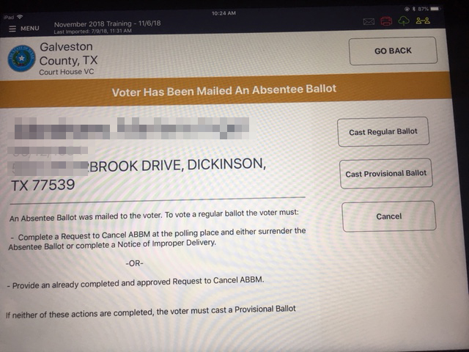
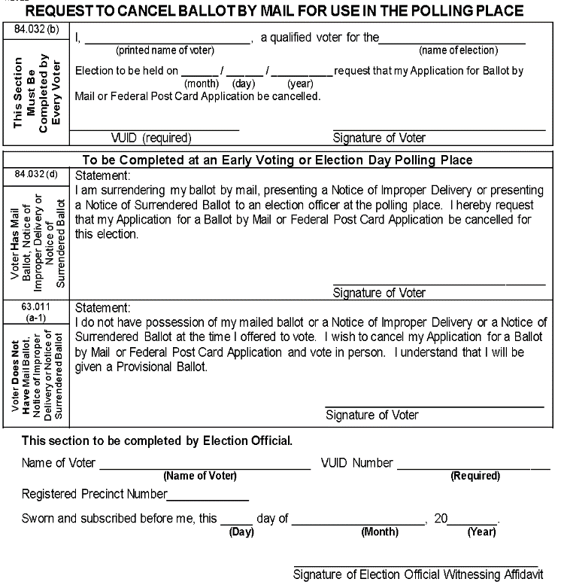
Special Circumstances
Mail Ballots:
  If the voter has been sent a mail ballot, the record on the search screen will be pink with a notation.
  The confirmation screen will have an amber banner.
  Process ballot cancellation before proceeding.
If the voter surrenders the mail ballot:
  Fill out the Request to Cancel Mail Ballot.
  Attach the cancelled ballot.
  Return in the envelope provided.
  Voter will cast a regular ballot.
If the voter DOES NOT bring back their mail ballot:
  Fill out Request to cancel Mail Ballot
  The voter must vote provisionally.
  Make sure to fill out the provisional envelope completely
Voter fills out these two sections only.
Judge will fill the bottom portion

Slide 33
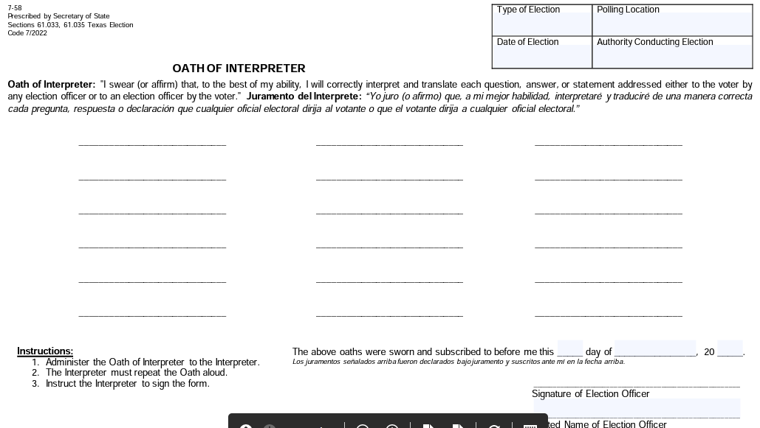
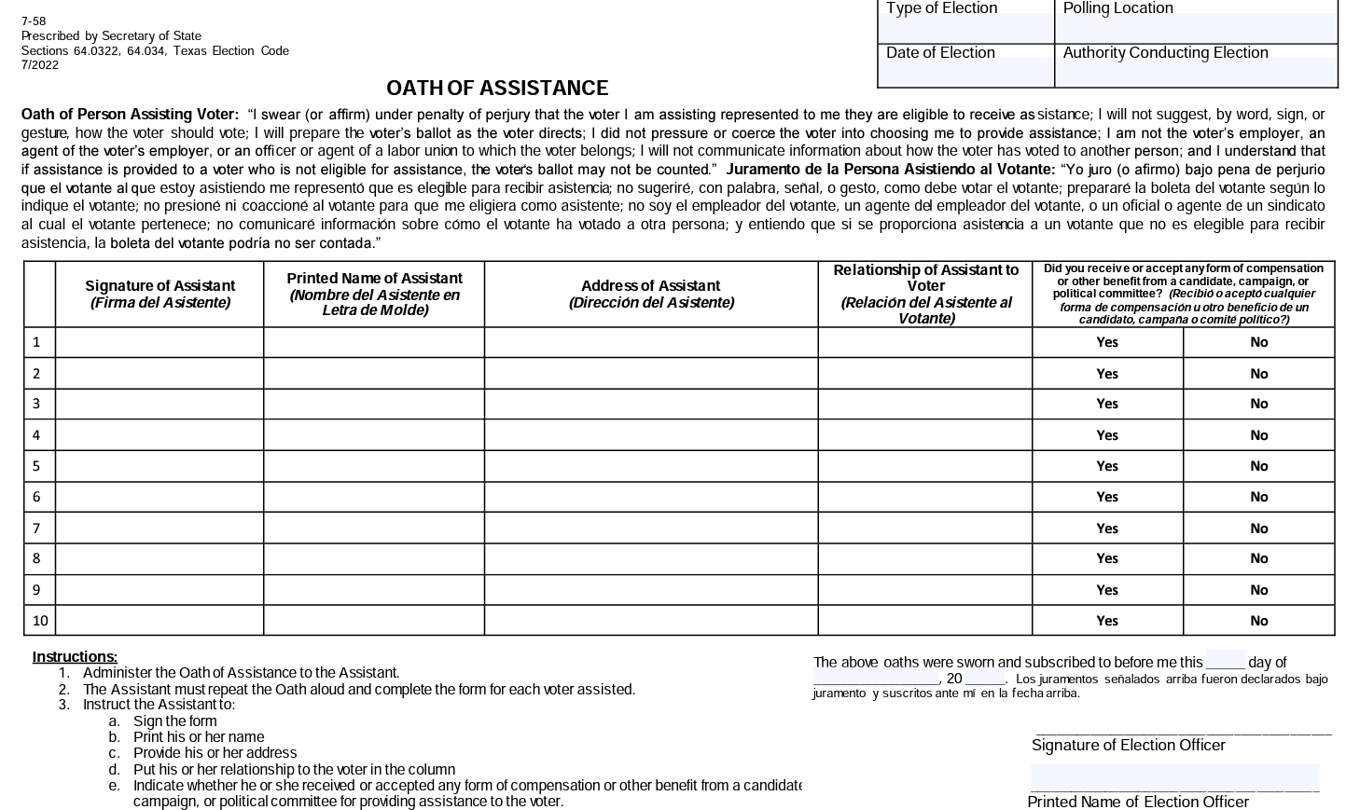
Special Circumstances
Voter Assistants:
  Voters needing assistance are regular voters, but an additional signature is needed.
    If already past the PollBook Check-in stage, use the provided forms.
  All poll-workers are already sworn in and trained as voter assistants.

Slide 34
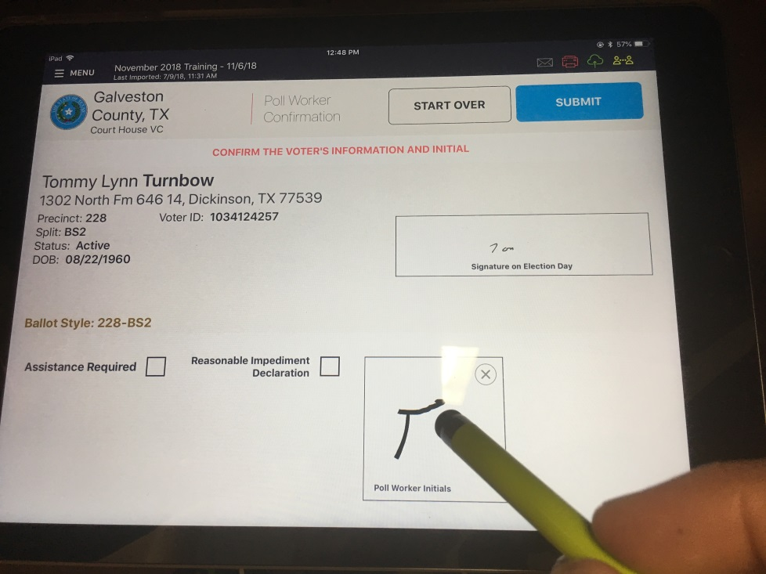
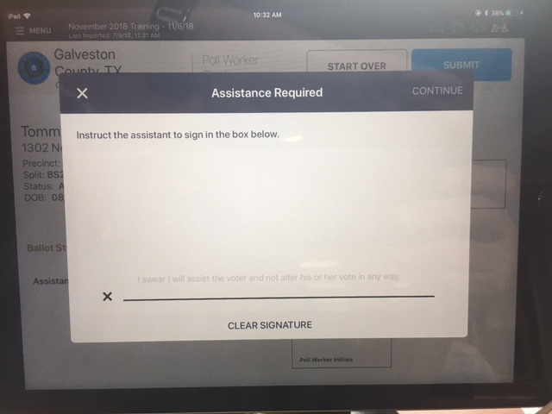
Special Circumstances
Voter Assistants:
  Anyone may assist a voter at the voter’s request.
  Assistant must sign the Poll Pad or fill out the Voter Assistant Form (Paper).
Touch Button
Assistant Signs
Notes:
The assistant must fill out the paper form because the laws have changed and the update is not on the poll pads yet.

Slide 35
Special Circumstances
Curbside Voter:
  Someone presents the voter’s ID. (can be anyone) Or you will receive a call from elections for you to go out to a vehicle
  Please do this 2 workers at a time! (This can be done by a judge or a clerk)
  Process through the Poll Pad. You may take the poll pad to allow the voter sign for themselves.
  Obtain an access code and PVR paper from the Controller.
  At the Duo, choose a language and enter the access code.
  Disconnect the Duo from its base station, and insert into the “Duo Go” unit, connecting the USB connector.
  Feed PVR paper into the printer at the top of the Duo Go.
Notes:
We may also have door bells to let you know when you have a curbside voter.

Slide 36
Special Circumstances
Curbside Voter:
  Inform the voter if the assistant has signed for the ballot if not have the voter sign the poll pad
  Allow the voter to vote.
  Make sure the voter touches “Print Ballot Record” when finished.
  Return the Duo device to the booth and reconnect.
  Insert the Printed Vote Record into the Scan device, and wait for the flag to appear, indicating that the vote has been counted.

Slide 37
Special Circumstances
Spoiling a Ballot:
  This should be handled by the judge.
  Reasons to spoil a ballot:
    The wrong ballot was issued.
    Voter decided not to vote before casting ballot.
    Paper jammed or printer malfunctioned.
    Voter walked off without casting ballot. (Poll workers may not cast the ballot!)
Notes:
There should be a new form for this from the Secretary of State however we have not gotten it yet.

Slide 38
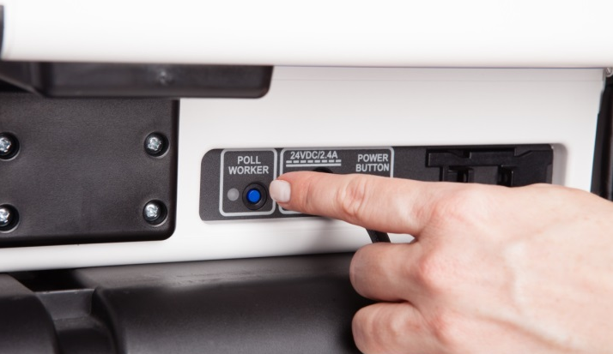
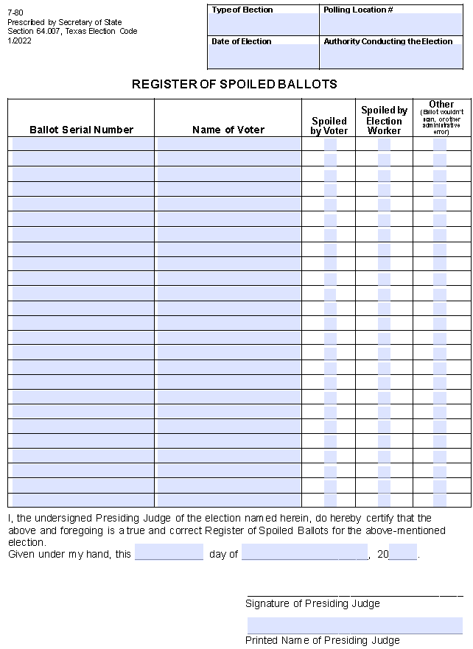
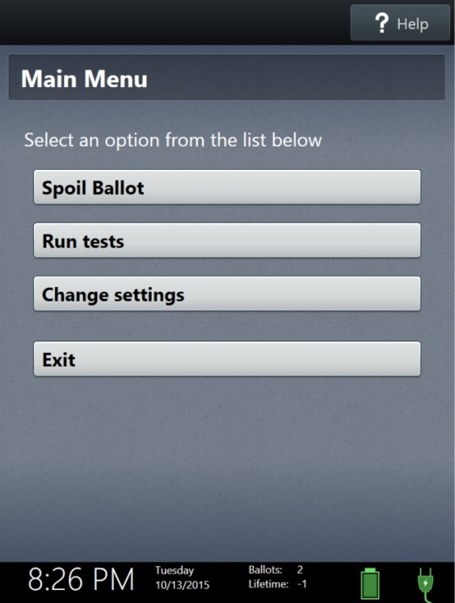
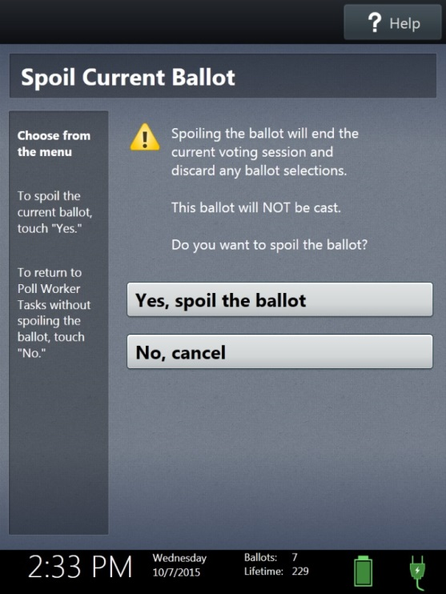
Special Circumstances
Spoiling a ballot:
  Press the blue “poll worker” button on the back of the Touch.
  Select “Spoil Ballot.”
  Enter the Poll Worker Code and select “Accept.”
  Select “Yes, spoil the ballot.”
  Select “OK.”
  Fill out the Spoiled Ballot Log

Slide 39
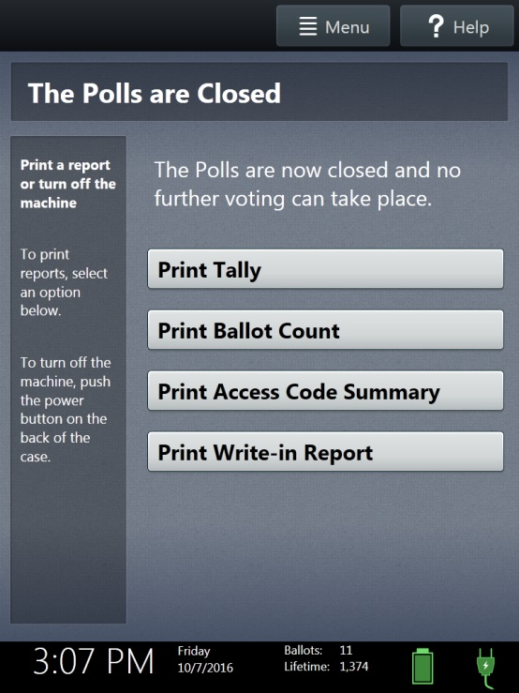
Summary & Forms
Reconciliation Logs:
  Election Day
    Step #1 – Gather Information.
      Controller: Print Access Code Summary
      Poll Pad: Check-in Count.
      Spoiled Ballot Log : Spoiled ballots that were not issued a replacement ballot.

Slide 40
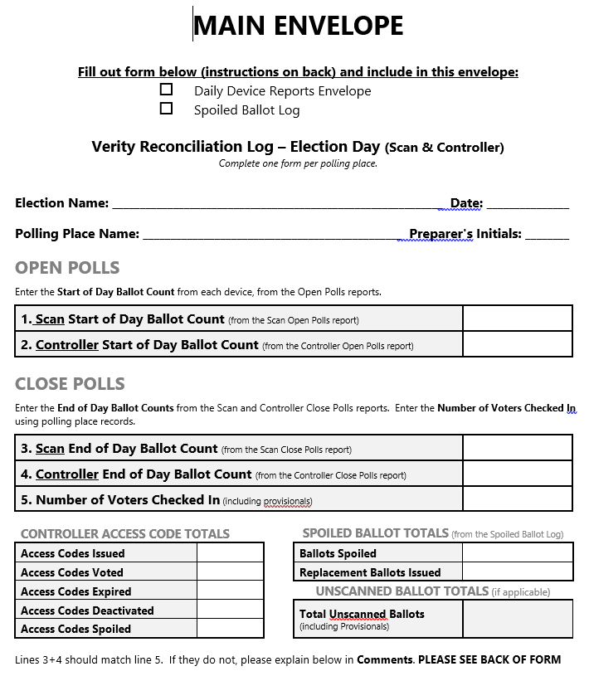
Summary & Forms
Reconciliation Logs:
  Election Day:
From Spoiled Ballot Log
From Scan
From Controller
From Poll Pad
From Access Code Report

Slide 41
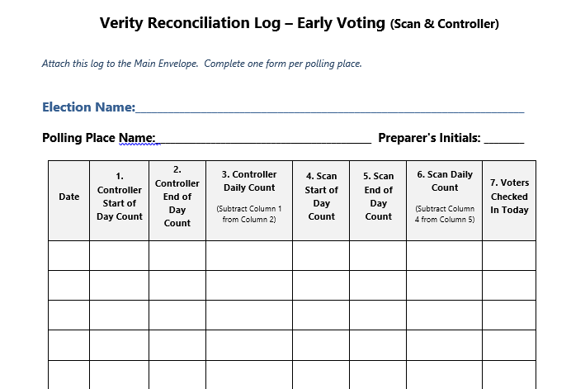
Summary & Forms
Reconciliation Logs:
  Early Voting
    Numbers come from Open and Close polls reports.
    Reports must be signed and saved.
Should match
From Controller
From Scan
From Poll Pads

Slide 42
Things to Remember
Electioneering is prohibited within 100 feet of the polling place entry.
Cell phone use is regulated.
Election workers should behave professionally.
When in doubt, call the Elections Office.

Slide 43

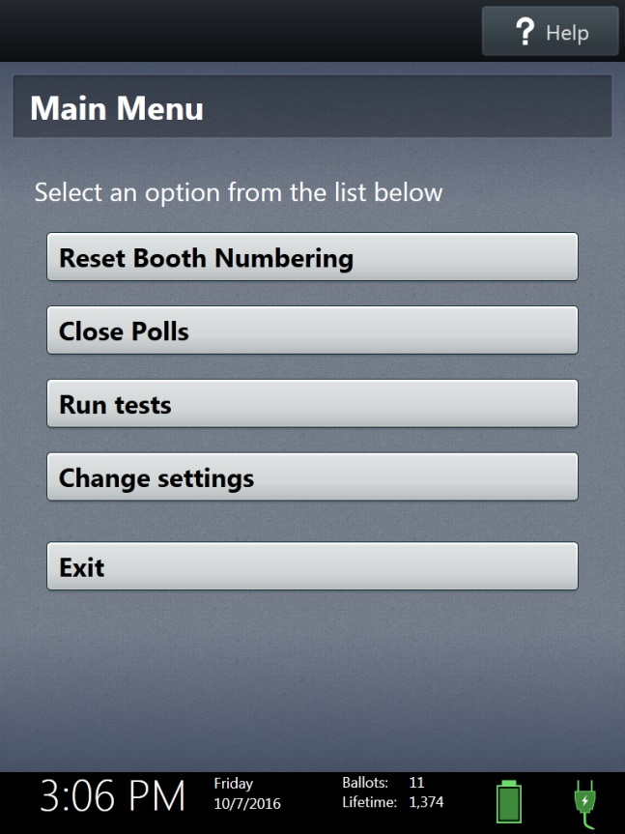
End of the Day
Close polls on Election Day or suspend polls during Early Voting.
  Select “Menu.”
  Choose “Close Polls” or “Suspend Polls.”
  Enter the Password and select “Accept.”
Once polls have closed, they cannot be reopened!

Slide 44
End of Day Checklist
Judge will complete reconciliation logs, payroll forms, and other paperwork.
Controller and Scanner locked and sealed (during Early Voting)
All poll workers assist in dismantling equipment, removing signs and notices, and removing all tape from cords and equipment.
Call the elections office with final numbers and time of polls closing.
Please call us when you are leaving to deliver the following:
  Controller and scanner
  Manilla Envelopes
  Provisional Bag
  MIFI (ED)
  Grey ballot bag with the VOTED ballots (Must have 2 locks on this bag)
  Grey bag with the blank ballot paper.

Slide 45
Thank You for Serving with
Galveston County Elections
Notes:
All workers MUST fill out paperwork with the county for payroll. Controllers must be taken in case of a fire. You can NOT remove v drives. If you can not make it to work call the elections office. There will be one mifi per location.

