Slide 1
Bond Forfeitures
Brent Haynes
Assistant Criminal District Attorney
Galveston County
Criminal District Attorney’s Office

Slide 5
Bail
Security given by the accused (the defendant) to ensure that he will appear in court for his case.
Tex. Code Crim. Proc. Section 17.01

Slide 6
Bond

Slide 7
Bond = Promise

Slide 8
Types of Bonds:
Personal Recognizance – P.R. Bonds
- Pre-Trial Services Bonds
- Personal Bond Office Bonds - CCP 17.42
Cash Bonds
Surety Bonds

Slide 9
2 Types of
Professional Sureties

Slide 10
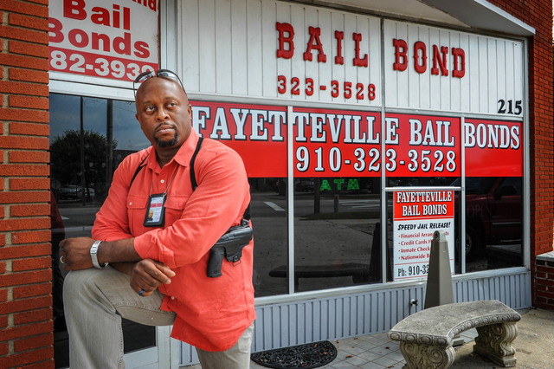
Real Persons-Human Beings:
Natural Persons
Individuals

Slide 11
Corporate Sureties
Insurance Companies

Slide 12
Sample Bond

Slide 13
Sample Bond

Slide 14
Defendant is the Principal:

Slide 15
Surety Name on Bond: Individual Surety

Slide 16
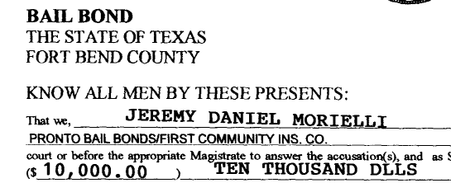
Surety Name on Bond: Insurance Surety

Slide 17
Assumed Name
“D/B/A”

Slide 18
Assumed Name
“D/B/A”

Slide 19
Ignore the “D/B/A”

Slide 20
Look for the Legal Name of the Surety

Slide 21
How do you know if the surety is an
insurance company?

Slide 22
Look for the “power”

Slide 23
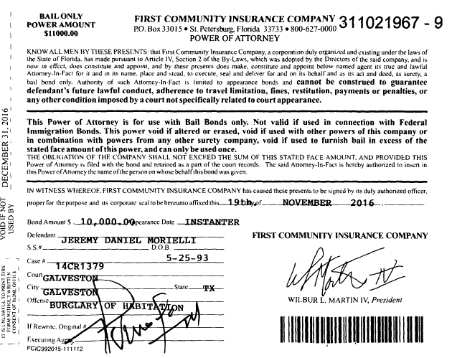
As in: “Power of Attorney”

Slide 24
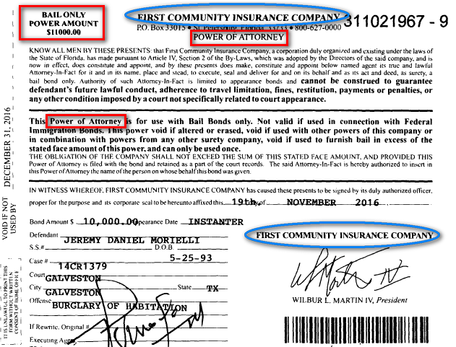

Slide 26
Court Appearances

Slide 27
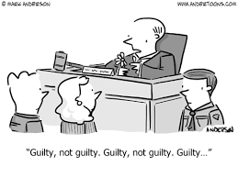
Case Closed = Bond Discharged
Dismissal
Acquittal
ODA
Community Supervision
Defendant is sentenced
CCP Art. 17.08 sec. 5

Slide 28
Cash Bond Refunds
Any cash funds deposited under this article shall be receipted for by the officer receiving the funds and, on order of the court, be refunded in the amount shown on the face of the receipt less the administrative fee authorized by Section 117.055, Local Government Code, after the defendant complies with the conditions of the defendant's bond, to:
Tex. Crim. Proc. Code Ann. § 17.02.

Slide 29
A Cash Bond is refunded to:
(1) any person in the name of whom a receipt was issued, including the defendant if a receipt was issued to the defendant; or
(2) the defendant, if no other person is able to produce a receipt for the funds.
Tex. Crim. Proc. Code Ann. § 17.02.

Slide 30
A Cash Bond is refunded to:
(1) any person in the name of whom a receipt was issued, including the defendant if a receipt was issued to the defendant; or
(2) the defendant, if no other person is able to produce a receipt for the funds.
Tex. Crim. Proc. Code Ann. § 17.02 (emphasis added).

Slide 31
A Cash Bond is refunded to:
(1) any person in the name of whom a receipt was issued, including the defendant if a receipt was issued to the defendant; or
(2) the defendant, if no other person is able to produce a receipt for the funds.
Tex. Crim. Proc. Code Ann. § 17.02 (emphasis added).

Slide 32
A Cash Bond is refunded to:
(1) any person in the name of whom a receipt was issued, including the defendant if a receipt was issued to the defendant; or
(2) the defendant, if no other person is able to produce a receipt for the funds.
Tex. Crim. Proc. Code Ann. § 17.02 (emphasis added).

Slide 33
Cash Bond Refunds
Any cash funds deposited under this article shall be receipted for by the officer receiving the funds and, on order of the court, be refunded in the amount shown on the face of the receipt less the administrative fee authorized by Section 117.055, Local Government Code, after the defendant complies with the conditions of the defendant's bond, to:
Tex. Crim. Proc. Code Ann. § 17.02 (emphasis added).

Slide 34
FTA:
Capias / Warrant
Bond Forfeiture

Slide 35
FTA
Capias / Warrant
Purpose: to get the D back in court
to resolve the criminal case

Slide 36
Bond Forfeiture:
To enforce the contract made when the bond was executed
Judgment Nisi
Judgment Unless

Slide 37
Scire Facias or Civil Docket:
CCP 22.10
The issuance of a judgment nisi is the start of a new case.
• The case is docketed on a scire facias docket or a civil docket.
• The State of Texas is the Plaintiff.
• The DP and his sureties are the defendants.
• The nisi—or bond forfeiture—case is governed by the Texas Rules of Civil Procedure, unless provided otherwise in Chapter 22, CCP.
• But, the case is still a criminal case—appeals are taken to the Court of Criminal Appeals, not the Texas Supreme Court.
• STATUTE OF LIMITATIONS: The State has four years from the FTA to file a BF case. CCP 22.18.

Slide 38
NOTE: The Judgment nisi should identify the surety by his, her, or its real name, not by an assumed name or d/b/a (doing business as).
(Remember: Ignore the D/B/A)
This also true for the citation.
For example: John J. Doe, surety, (not “John’s Bail Bonds”); or National Fidelity Ins. Co., agent John J. Doe, (not “John J. Doe”).

Slide 39
•Citation & Service of Process: CCP 22.03—22.08
• Citation is the same as in civil actions.
CCP 22.05.
BUT THERE ARE SEVERAL DIFFERENCES:

Slide 40
Citation & Service of Process: CCP 22.03—22.08
DIFFERENCES:
Citation Requirements:
A copy of the Judgment Nisi
A copy of the bond
A copy of the power of attorney
Notice that the parties “show cause why the judgment of forfeiture should not be made final.” CCP Art. 22.04

Slide 41
DEFENDANT EXCEPTION: The defendant does not receive citation and SOP as in normal civil actions.
• Instead: The DP is entitled to notice only if he provided his address on the bond, and then only by mail directed to the DP at that address or his last known address.
• Thus, the defendant is receiving notice (if there is an address for him), but, strictly speaking, he is not receiving citation and service of process as is usually required in civil cases.
CCP Art. 22.05

Slide 42
• CITATIONS TO SURETIES: CCP 22.03
• INDIVIDUAL SURETIES: citation is served at the address on the bond, or the last known address. CCP 22.03(b).
• CORPORATE SURETIES: citation is served on “the attorney designated for service of process by the corporation” under Texas Insurance Code Ch. 804. “Attorney” here does not mean lawyer; it means “agent.” CCP 22.03(c).
• Non-insurance corporations and other entities are normally required to designate with the Texas Secretary of State a “registered agent” for service of process. This information is on the Texas SOS website.
• Insurance companies are different. Insurance companies are regulated by the Texas Department of Insurance. Insurance companies are supposed to designate a person for service of process, but this person is called an “attorney,” not an agent. This information is available on the TDI website.
• Also, the “attorney” might not be a person; it might be a company, such as CT Corporation, whose business is to accept legal process for other businesses. These are the easiest to serve, because no particular human being is required to be served; just send the citation CMRRR.

Slide 43
CLERK’S NOTE: Finding the attorney for SOP for a corporate surety—an insurance company—means clicking through a few web pages, but is usually easy. Go to the TDI’s webpage.
• Do an internet search for “TDI attorney for service.”
• Choose the search result: “Guidelines for Service of Process-Texas Department of Insurance.”
• On the TDI Guidelines for Service of Process page click the “Company Lookup” link. This should bring up the:
• “Search for Company Profile” page, with a search box.
• Type the name of the insurance company, for example: National Fidelity.
• The results will produce or more options. Choose the option that identifies the insurance company as having an “Active” status.
• The insurance company’s data will appear; scroll to the “Attorney for Service” section.
• Follow the name and address given here exactly, (unless the insurance company has filed a waiver under 22.03(d)).

Slide 44
• Citation & Service of Process: Important Points
• The name on the citation must match the name of the judgment nisi.
• Do not use assumed names (d/b/a’s). Use the real name of the individual surety or the corporate surety. If a corporate surety, add the agent’s name.
• Individual surety example: “John J. Doe,” not John’s Bail Bonds.
• Corporate surety example: “National Ins. Co. agent John J. Doe,” not John J. Doe.
• When using Certified Mail, Return Receipt Requested, the signature on the green card must be legible and must match the name on the citation. If the signature is not legible, or a different person signs the green card, the SOP is invalid.

Slide 45
Concluding the BF Case
Remittur
Settlement
MSJ
Trial
SBOR > A new case filed by the Surety

Slide 46
Going off the Bond
CCP Art. 17.16 – Surrender
Affidavit of Incarceration
CCP Art. 17.19 – Surety WRT

Slide 47
Remember, when you have a question
always ask your prosecutor who prosecutes bond forfeitures.

