Slide 2
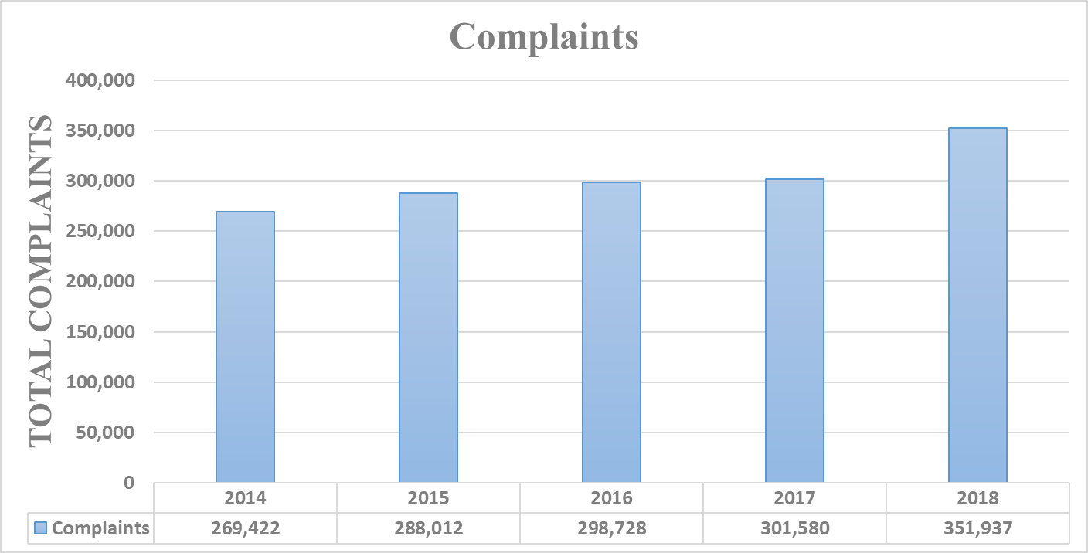

Slide 3
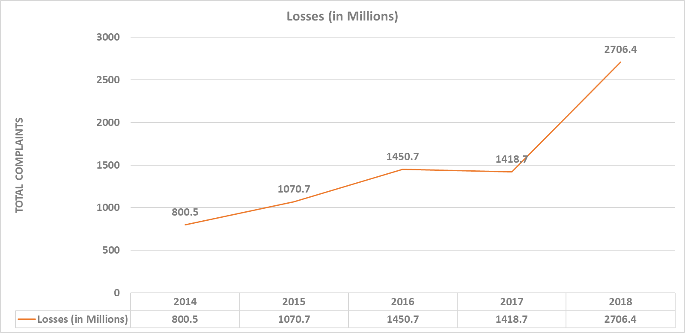

Slide 6
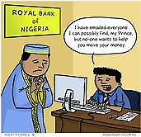

Slide 7
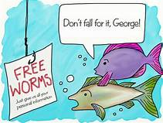

Slide 10
Recovery to Date:
02/02/2018 to12/31/2018
Incidents: 1,061
Losses: $257,096,991
Recovery: $192,699,195
Recovery Rate: 75%

Slide 11
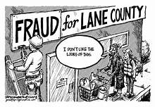
GALVESTON HHHHHHHHH

