Slide 1
Local Rules, Forms, and Standing Orders
The Office of Court Administration
11/9/2022
Notes:
Welcome to the Local Rules, Forms and Standing Order Webinar. My name is Sheri Woodfin and I am a Court Consultant for the Office of Court Admin. Also joining and assisting in this presentation is Kelly Tibedoaux, Executive Assistant to Megan Lavoie and Samuel Nichols, who is the project manager.
I would like to remind everyone that this is being recorded. If you have questions we encourage you to place them in the chat. We have built Frequently asked Q & A into the presentation, so you may want to hold your questions to the end. Later in the presentation, Mr. Nichols will be doing a demonstration of the Court tools, where these documents will be uploaded.

Slide 2
The Rules & Orders
Texas Rule of Civil Procedure 3a
Texas Rule of Appellate Procedure 1.2
Texas Rule of Judicial Administration 10
Supreme Court Misc. Docket No. 22-9081, Court of Criminal Appeals Misc. Docket No. 22-006
Notes:
The SC and Court of Appeals entered Order on the Misc. Docket that amended- Rules of Civil Procedure 3a, Texas Rules of Appellate Procedure 1.2 and Rule 10 of Texas Rules of Judicial Administration

Slide 3
TX Rules of Civil Procedure –Rule 3a Local Rules, Forms, and Standing Orders
Misc. Docket Orders signed September 20 &23, 2022
Effective January 1, 2023
Office of Court Administration(OCA) website is live to clerks and courts beginning 11/1/2022 to provide adequate time for posting documents before the effective date.
Courts will upload their local rules, forms and standing orders to the OCA website here:
https://courtal.txcourts.gov/
Notes:
These orders were signed Sept. 2022 and are in effect beginning Jan. 1, 2023. The website is now live for courts to begin posting documents well before the effective date. Courts will upload their local rules, forms and standing order at: courtal.tx.courts.gov/

Slide 4
RULE 3a. LOCAL RULES, FORMS, AND STANDING ORDERS
(a) General Rule. An administrative judicial region or a court governed by these rules may promulgate local rules, forms, and standing orders that govern local practice.
(b) Relationship with Other Authorities. Local rules, forms, and standing orders must not be inconsistent with state or federal law or rules adopted by the Supreme Court of Texas. This requirement extends to any time period provided by these rules. If adopted by a court, local rules, forms, and standing orders must not be inconsistent with any rule of the administrative judicial region in which the court is located.
(c) Publication Required. To be effective, local rules, forms, and standing orders must be published on the Office of Court Administration’s website.
Notes:
Rules of Civil Procedure - Rule 3a.

Slide 5
RULE 3a. LOCAL RULES, FORMS, AND STANDING ORDERS
Comment to 2023 change: Rule 3a is amended to remove the requirement that the Supreme Court of Texas approve local rules and to expressly address local forms and standing orders. The amended rule provides that local rules, forms, and standing orders must not conflict with other laws or rules and that they are not effective unless published on the Office of Court Administration’s website. Section 74.093(b) of the Texas Government Code imposes additional requirements for local rules.

Slide 6
Texas Government Code 74.093
Sec. 74.093. RULES OF ADMINISTRATION. (a) The district and statutory county court judges in each county shall, by majority vote, adopt local rules of administration.
(b) The rules must provide for:
(1) assignment, docketing, transfer, and hearing of all cases, subject to jurisdictional limitations of the district courts and statutory county courts;
(2) designation of court divisions or branches responsible for certain matters;
(3) holding court at least once a week in the county unless in the opinion of the local administrative judge sessions at other intervals will result in more efficient court administration;
Notes:
Government Cde 74.093

Slide 7
Texas Government Code 74.093
(4) fair and equitable division of caseloads; and
(5) plans for judicial vacation, sick leave, attendance at educational programs, and similar matters.
(c) The rules may provide for:
(1) the selection and authority of a presiding judge of the courts giving preference to a specified class of cases, such as civil, criminal, juvenile, or family law cases;
(2) other strategies for managing cases that require special judicial attention;
(3) a coordinated response for the transaction of essential judicial functions in the event of a disaster; and
(4) any other matter necessary to carry out this chapter or to improve the administration and management of the court system and its auxiliary services.

Slide 8
Texas Government Code 74.093
(c-1) The rules may provide for the establishment and maintenance of the lists required by Section 37.003, including the establishment and maintenance of more than one of a list required by that section that is categorized by the type of case, such as family law or probate law, and the person's qualifications.
(d) Rules relating to the transfer of cases or proceedings shall not allow the transfer of cases from one court to another unless the cases are within the jurisdiction of the court to which it is transferred. When a case is transferred from one court to another as provided under this section, all processes, writs, bonds, recognizances, or other obligations issued from the transferring court are returnable to the court to which the case is transferred as if originally issued by that court.

Slide 9
Texas Rules of Appellate Procedure – Rule 1
Rule 1. Scope of Rule; Local Rules of Courts of Appeals
1.1. Scope
These rules govern procedure in appellate courts and before appellate judges and post-trial procedure in trial courts in criminal cases.
1.2. Local Rules and Forms
(a) Promulgation. A court of appeals may promulgate rules and forms governing its practice that are not inconsistent with state or federal law or rules adopted by the Supreme Court or the Court of Criminal Appeals. To be effective, local rules and forms must be published on the Office of Court Administration’s website.
(b) Party’s Noncompliance. A court must not dismiss an appeal due to a party’s failure to comply with a local rule or form without giving the noncomplying party notice and a reasonable opportunity to cure the noncompliance.
Notes:
Rules of Appellate Procedure – Rule 1

Slide 10
Texas Rules of Appellate Procedure – Rule 1
Comment to 2023 change: Rule 1.2 is amended to remove the requirement that the Supreme Court of Texas and Court of Criminal Appeals approve local rules and to expressly address local forms. The amended rule provides that local rules and forms must not conflict with other laws or rules and that they are not effective unless published on the Office of Court Administration’s website.

Slide 11
Texas Rules of Judicial Administration- Rule 10
Rule 10. Local Rules, Forms, and Standing Orders.
(a) General Rule. Local rules, forms, and standing orders must not be inconsistent with other laws or rules and must be published on the Office of Court Administration’s website.
(b) Multi-Court Counties. In multi-court counties having two or more court divisions, each division must adopt a single set of local rules, forms, and standing orders that govern all courts in the division.
Notes:
Rules of Judicial Administration- Rule 10

Slide 12
Texas Rules of Judicial Administration- Rule 10
(c) Local Rule Contents. Local rules must include:
(1) provisions for fair distribution of the caseload among the judges in the county;
(2) designation of the responsibility for emergency and special matters;
(3) plans for judicial vacation, sick leave, attendance at educational programs, and similar matters; and
(4) any other content required by sections 27.061 or 74.093(b) of the Texas Government Code.

Slide 13
Texas Rules of Judicial Administration- Rule 10
(d) Format. Local rules, forms, and standing orders must be submitted in a format specified by the Office of Court Administration.
(e) Presiding Judge Authority. The presiding judge of an administrative judicial region may direct a court in the region to amend or withdraw a local rule, form, or standing order if the presiding judge determines that the rule, form, or standing order fails to comply with Rule 3a of the Texas Rules of Civil Procedure or that it is unfair or unduly burdensome.
(f) Supreme Court Authority. The Supreme Court may direct a court to amend or withdraw a local rule, form, or standing order if the Supreme Court determines that the rule, form, or standing order fails to comply with Rule 3a of the Texas Rules of Civil Procedure or Rule 1.2 of the Texas Rules of Appellate Procedure or that it is unfair or unduly burdensome.

Slide 14
Conflict Resolution Information
Rule of Judicial Administration 10 (e) & (f) set out a review process of local rules/forms/standing orders that may conflict with other rules/laws, be overly burdensome, etc., by providing the presiding administrative judge and the Supreme Court the authority to amend or withdraw local rules that do not comply.
The public website https://topics.txcourts.gov/ (live to public on January 1, 2023) will direct attorneys and the public with the following instruction:
“Complaints that a local rule, form, or standing order conflicts with other laws or rules, is ineffective, or is unfair or unduly burdensome may be presented first in writing to the presiding judge of the administrative judicial region in which the court is located, then in writing to the Supreme Court of Texas at rulescomments@txcourts.gov.”
Notes:
Conflict resolution is important to mention as rule 10 of the Rules of Administration e & f, set out a review process. Upon completion of the public website where the rules, forms and standing order will be avialable for the public, the messaging will provide: “Complaints that a local rule, form, or standing order conflicts with other laws or rules, is ineffective, or is unfair or unduly burdensome may be presented first in writing to the presiding judge of the administrative judicial region in which the court is located, then in writing to the Supreme Court of Texas at rulescomments@txcourts.gov.”

Slide 15
Texas Rules of Judicial Administration- Rule 10
Comment to 2023 change: Rule 10 is amended to implement the changes to Texas Rule of Civil Procedure 3a and Texas Rule of Appellate Procedure 1.2. But it also applies to local justice court rules authorized by section 27.061 of the Texas Government Code. Paragraphs (e) and (f) expressly authorize the regional presiding judges and the Supreme Court to direct changes to or the repeal of local rules, forms, and standing orders.

Slide 16
OCA Website Review
Notes:
On the OCA website txcourts.gov under the Rules & Forms Tab and under Clerk Information and Instruction is where you can locate access to the link to upload documents.

Slide 17
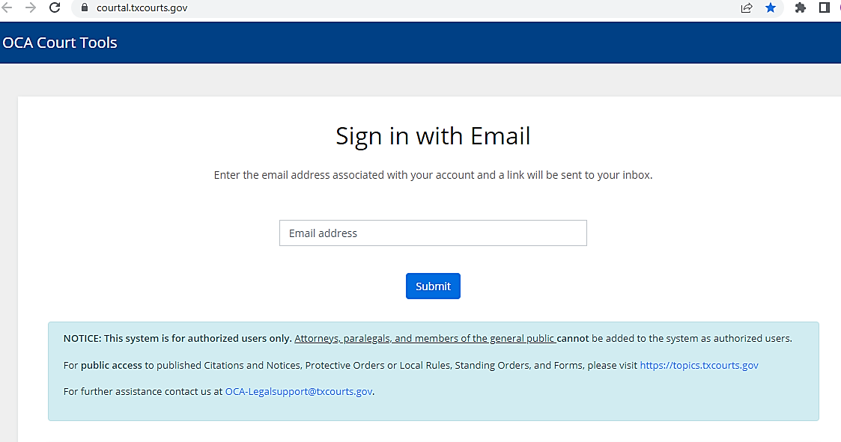
For authorized user information and user guide contact: oca-legalsupport@txcourts.gov
Notes:
This system is for authorized users only. Attorneys, paralegal and members of the general public cannot be added to the system as authorized users. They would be able to review documents through the public website at https://topics.txcourts.gov
For clerks who already use the system with PO and CitP is just another module within the Courtal. Access to this module can be set up in the user account (or someone who can manage user rights can go to their account) and assign the role to manage their local rules. As soon as their record is saved, the option will appear in the menu bar at the top of the screen (if they change it for themselves) or they can log off and back in to see the role (if updated by another user)Mr. Nichols is going to provide a demonstration of the site for clerks to upload documents.(Sam takes this for demonstration. )

Slide 18
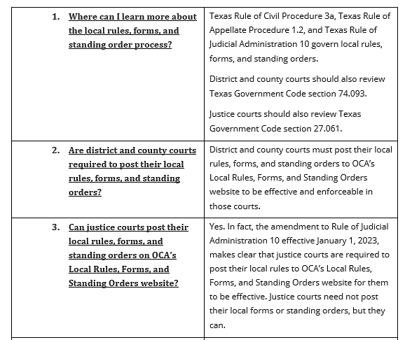
Frequently Asked Questions & Answers

Slide 19
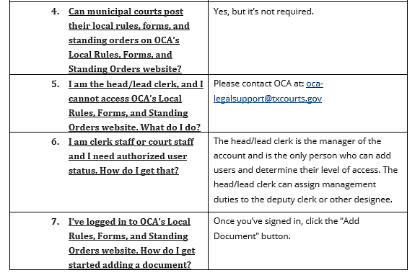
Frequently Asked Questions & Answers

Slide 20
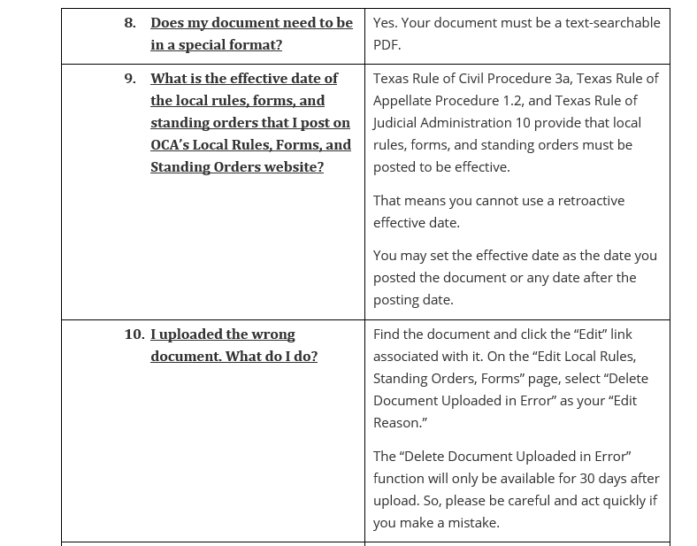
Frequently Asked Questions & Answers

Slide 21
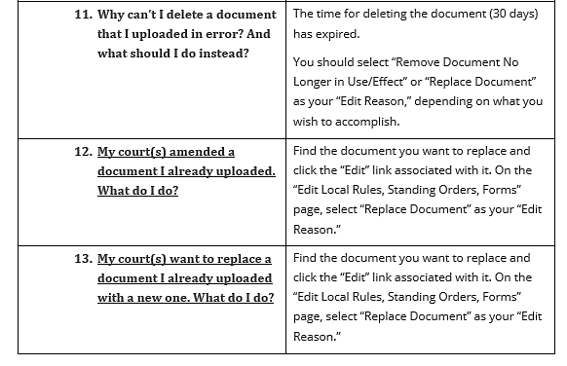
Frequently Asked Questions & Answers

Slide 22
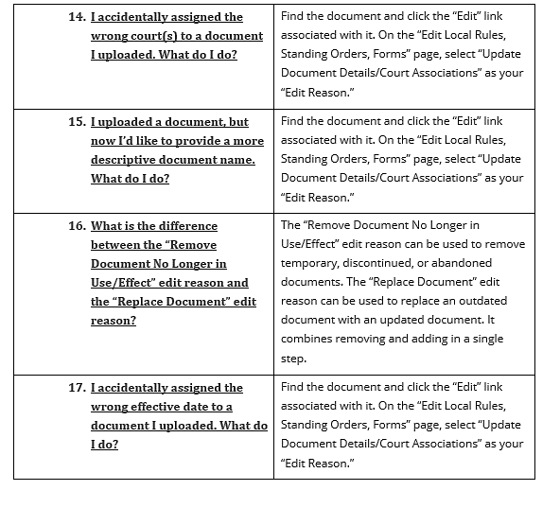
Frequently Asked Questions & Answers

Slide 23
This Photo by Unknown Author is licensed under CC BY-SA-NC
Notes:
Frequently asked questions can be covered as well as any additional questions after presentation.

