Slide 1
Fraudulent Documents
Joyce Hudman, Brazoria County Clerk
(979) 864-1359
111 E. Locust, Suite 200
Angleton, TX 77515

Slide 2
“I do not know of a statute that requires or authorizes this document to be recorded, it is irregular on its face.”
Here are a few examples of what we have received in my office.
I have a paper copy if you would like to view the entire documents.

Slide 3
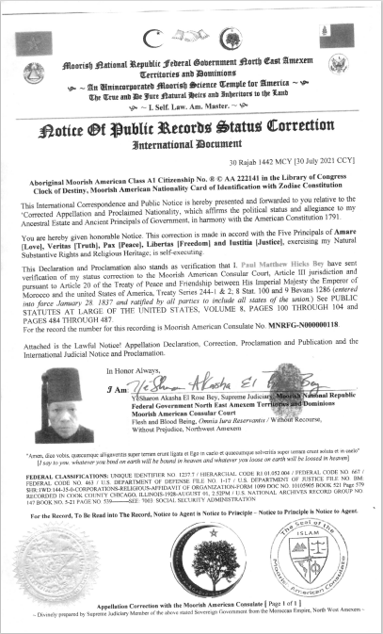
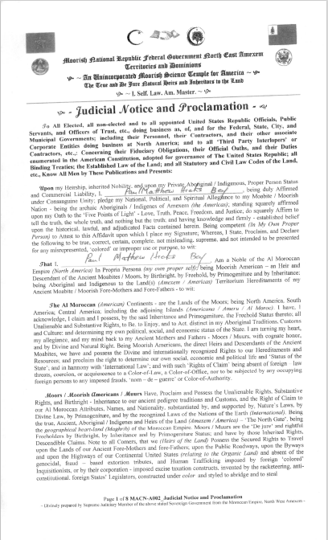

Slide 4
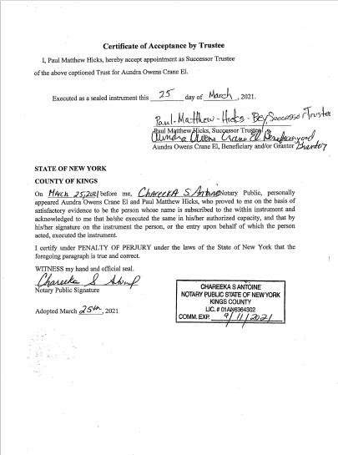
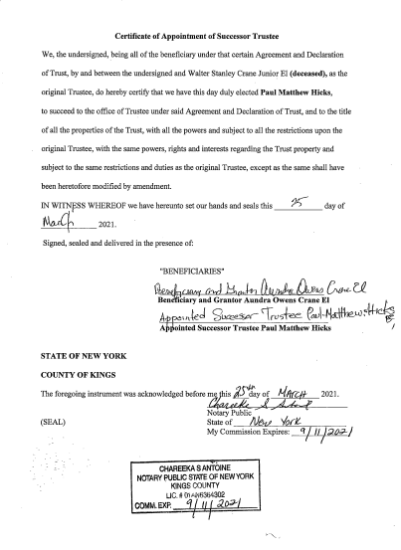

Slide 5
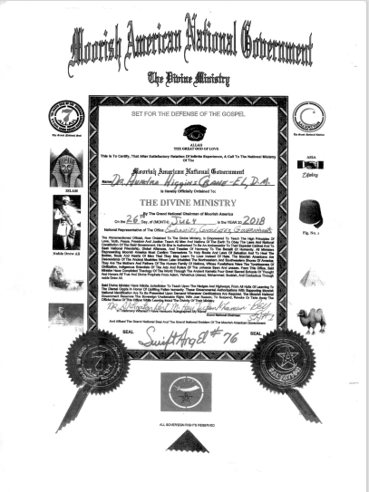
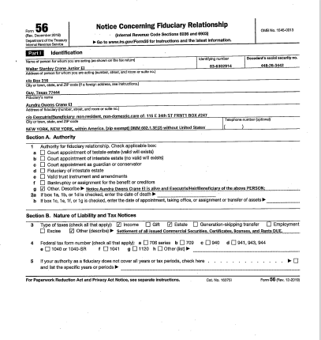

Slide 6
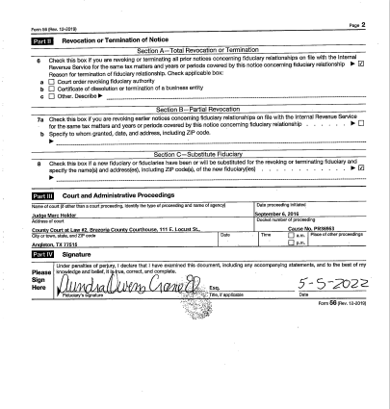
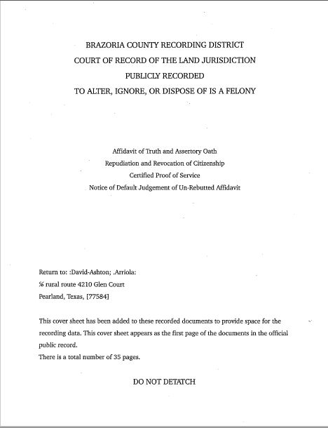

Slide 7
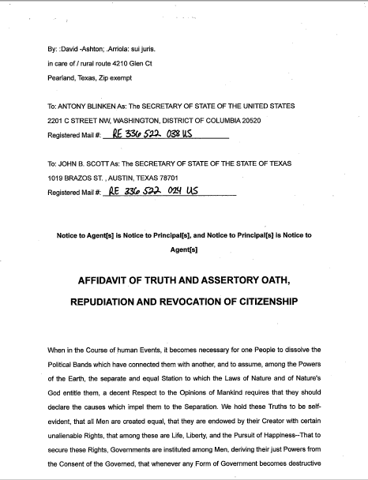
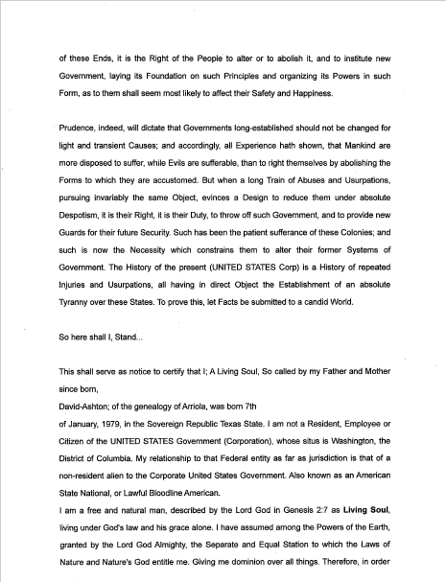

Slide 8
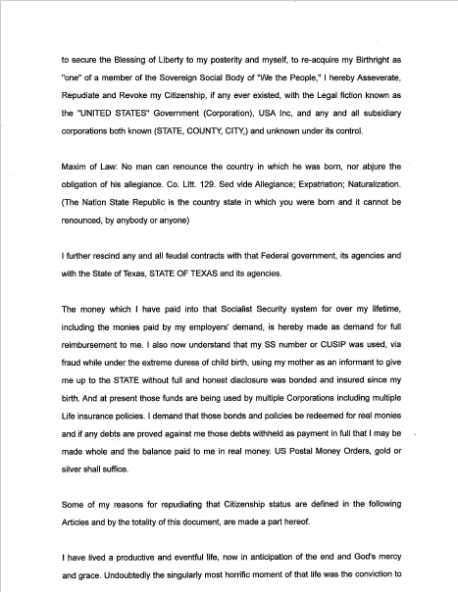
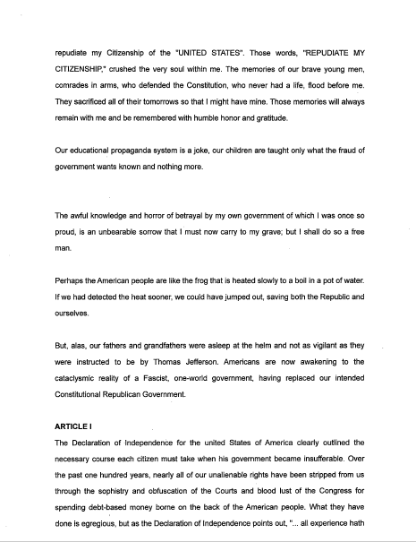

Slide 9
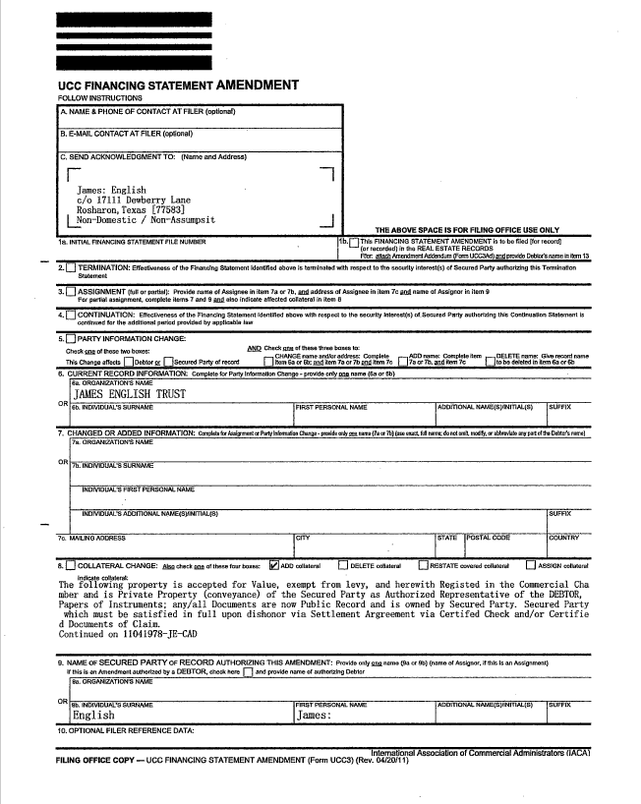
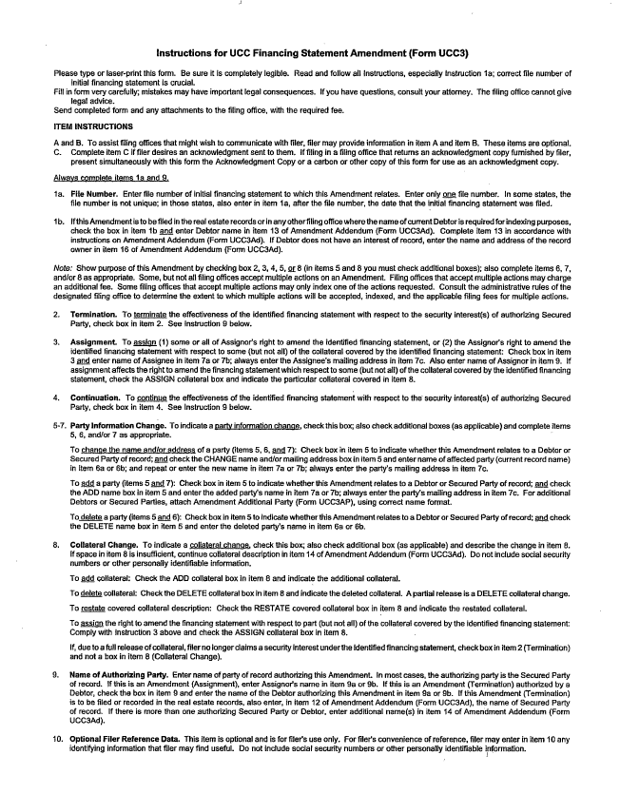

Slide 10
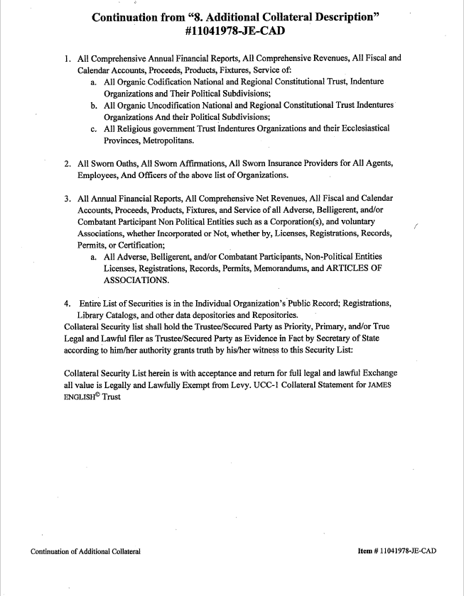
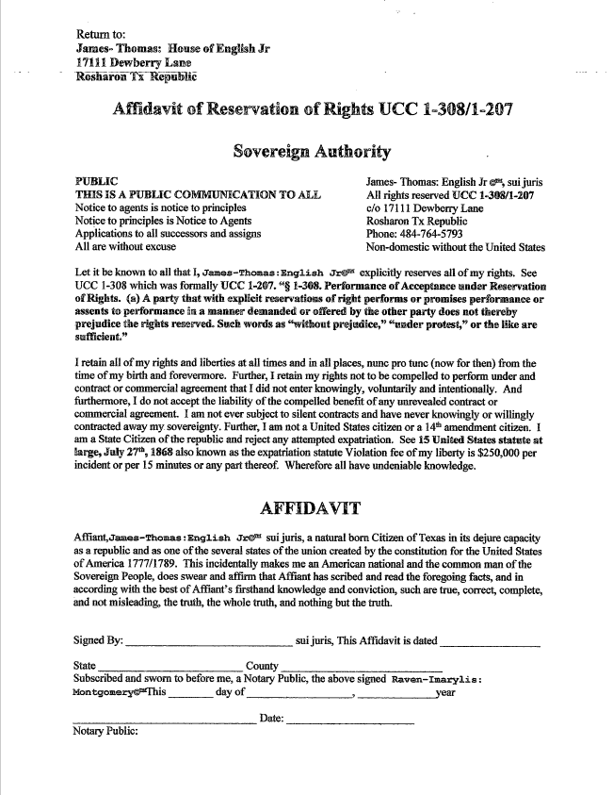

Slide 11
Submitter: CSC (Corporation Service Company/Ingeo)
Deeds.com
Individual attempted to e-record his Trust paper work.
Joshua McFerran – Recorded fraudulent deeds as soon as someone passes away the Deeds are assigned to HUD (US Housing & Urban Development)

Slide 12
Property Fraud is when someone illegally uses your property for financial gain.
How does it happen?
Someone records a document in the County Clerk’s Office attempting to make it look like they own your home or property.
This Photo by Unknown Author is licensed under CC BY

Slide 13
What can you do to protect your property?
By signing up with Property Fraud Alert you will receive a message by phone or email alerting you when a document is recorded in the County Clerk’s office under your name. This is a free subscription that automatically renews for 99 years.
It is easy to sign up. Just follow these five simple steps:
Step 1: Go to www.propertyfraudalert.com/TXBrazoria

Slide 14
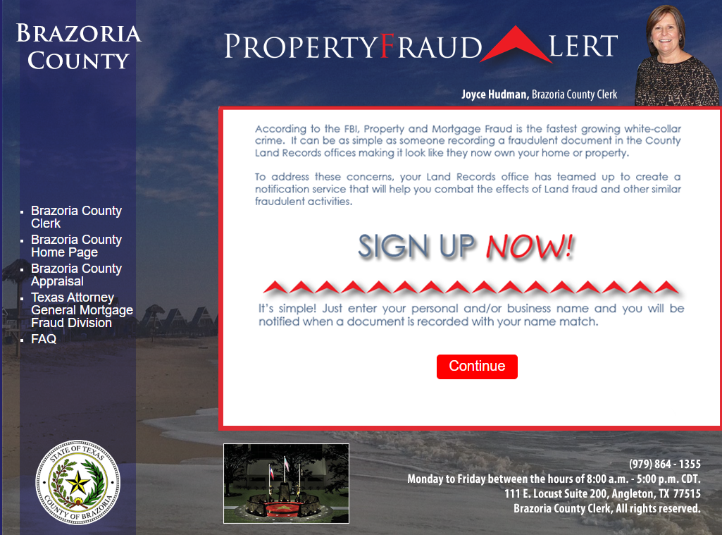
Step 2: Click

Slide 15
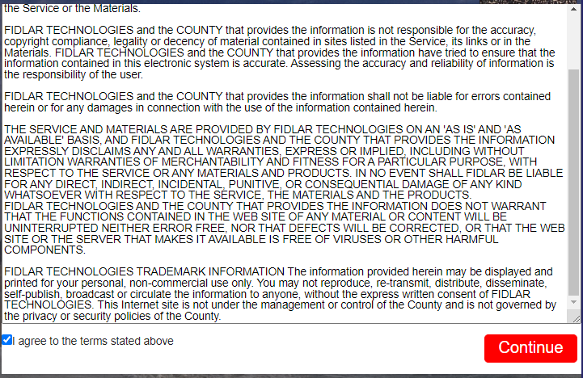
Step 3: Agree to the terms and Click

Slide 16
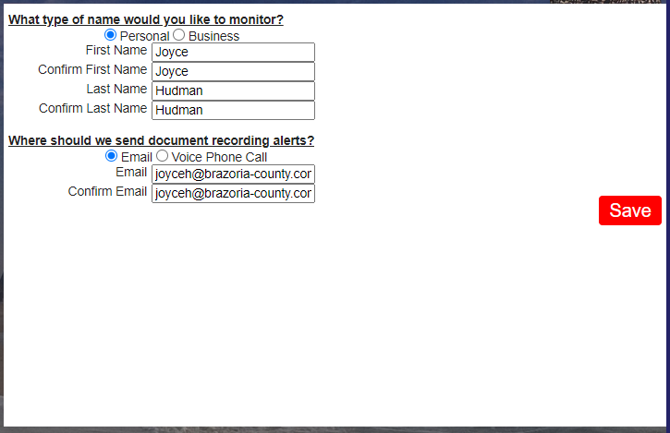
Step 4: Fill out your information and click

Slide 17
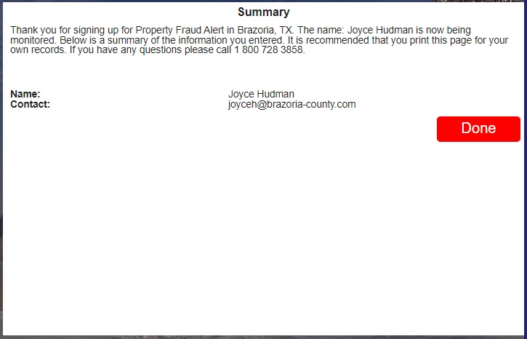
Step 5: Click

